Slide 1
Phrasal Verbs

Slide 2
What are phrasal verbs?
Back up
Get over
Break down
Turn on
Take off
Look away
The difference between phrasal and prepositional verbs is whether the meaning of the verb is literal or symbolic.

Slide 3
Phrasal vs. Prepositional Verbs
 | Prepositional Verbs | Phrasal Verbs
Get over
Back up
Break down
Stand for
Look ahead
Take off
Make out
The child could not get over the fence to reach the ball.
Sarah could not get over her breakup.
He managed to back up his father’s car into a wall and break the bumper.
You didn’t back me up during my argument with my boss! ☹
My car broke down in the middle of the motorway.
Sarah broke down and cried when he told her he was leaving her.
We are standing for the free ice-cream.
Women must stand for their reproductive rights.
If you look ahead, you will see the Statue of Liberty.
Looking ahead, our company plans to open offices around the world.
It is customary to take off your shoes when entering a Slavic household.
Boris is really good at taking off politicians, it’s so funny.
I cannot make out who that is from so far away with no glasses.
Sarah saw him making out with his new girlfriend at the party.

Slide 4
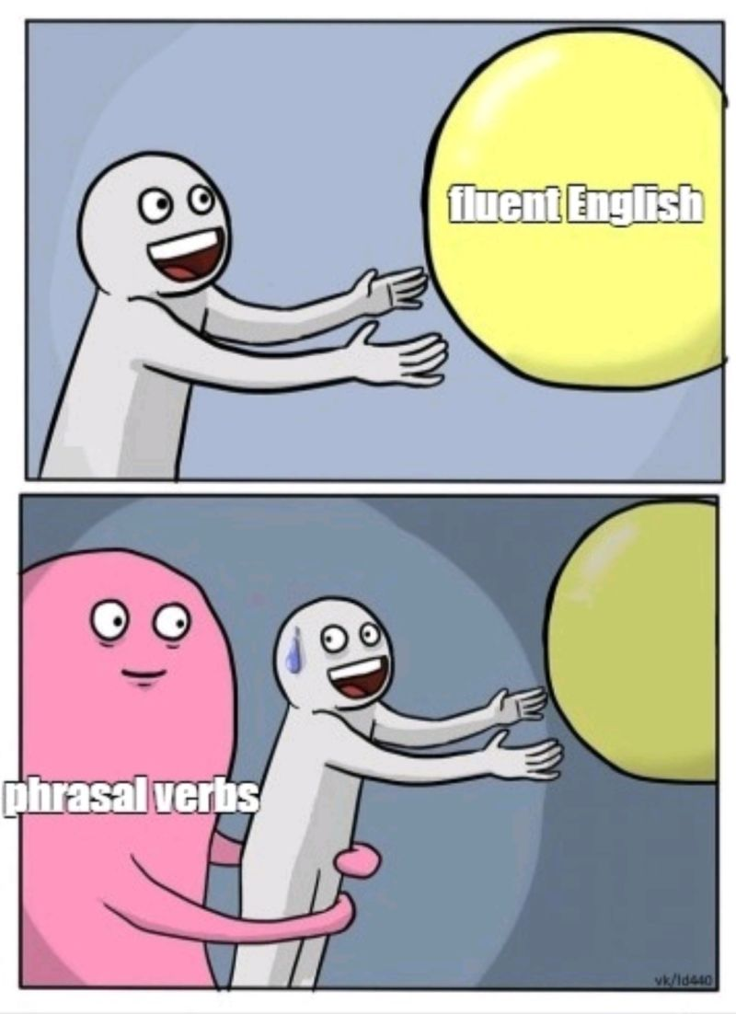
Types of Phrasal Verbs
With an object (transitive)
Without an object (intransitive)
Phrasal verbs can also have both a particle and a preposition
(look forward to, get along with, come down with, look up to...)
I can’t put up with my neighbour’s dog any longer!
If I’m late, you can go on without me and order food.

Slide 5
Types of Phrasal Verbs
Those with an object can sometimes be separated:
...but not always!
Sometimes they MUST be separated:
Those without an object can never be separated:
She forgot to switch the computer off before going to sleep.
I can’t put up with my neighbour’s dog any longer!
We went over my contract at my new job before I signed it.
The end of this film always gets me down.
If I’m late, you can go on without me and order food.

Slide 6
Phrasal Verb Practice:
Grammar, page 41, exercise XIV
Grammar, page 42, exercise XVII
exercise XVIII

Slide 7
Some brain teasers with Phrasal Verbs
What kind of running means walking?
What do you throw out when you want to use it, but take it in when you don’t want to use it?
Four cars come to a four-way stop, all coming from a different direction. They can't decide who got there first, so they all go forward at the same time. They do not crash into each other, but all four cars go. How is this possible?
What goes through cities and fields, but never moves?
Which tire doesn’t move around when a car turns right?
Running out of gas
An anchor
It was a right-hand turn / a roundabout
A road
The spare tire

Slide 8
Discussion Questions:
What are you looking forward to these days?
When something is broken in your home, who sorts out the problem?
When something is difficult, do you give up easily?
If someone cuts you off when you’re in the middle of a sentence, do you get annoyed?
What signs tell you that you might be coming down with a cold?
Where do you usually hang out with friends?
How often do you work out? What exercises do you do?
Who is someone in the world that you look up to?
What do you look for in a romantic partner? Good looks? Intelligence? Something else?
If your friends were feeling sad, how would you cheer them up?
Which events or activities do you dress up for?
Is it easy to get along with everyone? Or are some people too hard to get along with?
How can a person get over heartbreak quickly?
Who usually took care of you when you were a child?
Which of your parents do you take after more?

