Slide 1
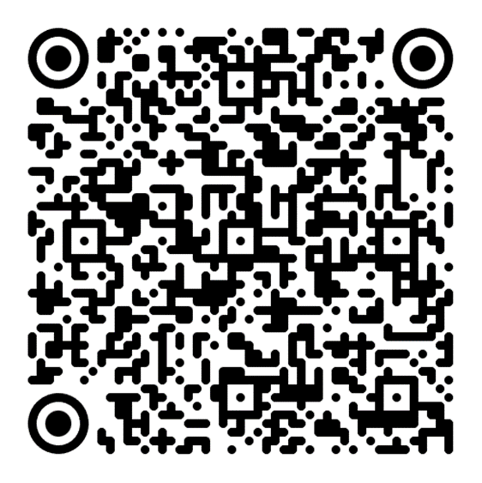
SIMPLE tenses

Slide 2
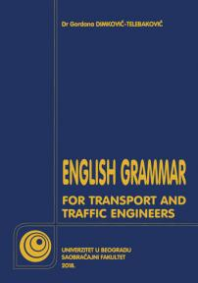
E-mail: s.stefanovic@sf.bg.ac.rs
Consultation hours: Mondays 12h-13h (room 05)
Moodle: nastava.sf.bg.ac.rs
Student books:

Slide 3
Present Simple – How do we make it?
Statements
Questions
Negations
Same form as the bare infinitive, except in the 3rd person singular!
I work∅
You work∅
He/she workS
1. We work∅
2. You work∅
3. They work∅
Present simple tense of the verb to do + inversion + infinitive
I do work -> Do I work? 1. We do work -> Do we work
You do work -> Do you work? 2. You do work
He does work -> ? 3. They do work
Same process as for the questions + not, but leave out the inversion!
I do not work 1. We do not work
You do not work 2. You do not work
He does not work 3. They do not work

Slide 4
Present Simple – When do we use it?
Facts
Habits
General statements
100% certain future actions
Water boils at 100°C. / Good transport facilitates the distribution of goods.
I always eat breakfast when I wake up. / Every day he takes the tram to work.
You all speak English well. / She generally finds people confusing.
We attack at dawn! / I go home this Friday, but I come back two days later.

Slide 5
Past Simple – How do we make it?
Statements
Questions
Negations
The bare infinitive + -ed for regular verbs
I worked
You worked
He/she worked
1. We worked
2. You worked
3. They worked
Past simple tense of the verb to do (aux) + inversion + infinitive
I did work -> Did I work? 1. We did work -> Did we work
You did work -> Did you work? 2. You did work
He did work -> ? 3. They did work
Same process as for the questions + not, but leave out the inversion!
I did not work 1. We did not work
You did not work 2. You did not work
He did not work 3. They did not work

Slide 6
Past Simple – When do we use it?
Past actions that are not connected to the present
Past actions that happened at a specified time
In indirect speech (for reporting present actions in the past)
In the subjunctive
Originally, vehicles had steam engines. / People once lived in caves.
Porsche invented the first hybrid car in 1899. / Yesterday I went to a spa.
She said: “I go to this cafe every day“. -> She said she went to that cafe every day.
I wish you were here. / I’d rather you didn’t. / He acts as if he owned the place.

Slide 7
Future Simple: a tense that is not a tense
Three ways to make it:
Modal will + bare infinitive
Semi-modal going to + bare infinitive
Present continuous

Slide 8
Expressing the future with will
Modal V will – spontaneous decisions, uncertain probability, not factual.
Will used like all modal verbs + bare infinitive
I think I’ll order the pasta. / I will probably go to Greece soon. / I’ll do the dishes later.
Bare infinitive vs. Full infinitive: to work to work I will work wherever I want! I will work as a garbage collector if I want to!

Slide 9
Expressing the future with going to
Semi-modal going to – usually interchangeable with will (a matter of choice), but a slightly higher probability!
Also used with the bare infinitive
I think I’m going to order the pasta. / I’m going to do the dishes later.
I’m going to to go to the police if the neighbours don’t stop playing loud music at 2 in the morning!

Slide 10
Expressing the future with present continuous
Tense used to express a certain, planned, scheduled future.
(more on continuous tenses the following week)
I’m ordering the pasta when we go to dinner. / I’m going to Greece this summer / I’m doing the dishes tonight since you cooked !

Slide 11
Practical exercises
English grammar: page 23, 24 – ex. I, sentences: 1, 4, 6, 26, 28, 30
Testovi: page 3 – sentence 1, 2
page 4 – sentence 2, 3
page 8 – sentence 1
page 9 – sentence 1, 3
page 10 – sentence 1, 2
page 15 – sentence 2, 4
page 17 – exercise IX, sentence 1, 2
page 18 – sentence 1
page 25, exercise IX, sentence 3, 5
page 28, sentence 6 (translation)
page 30, exercise IX, sentence 1, 3, 5
page 35, exercise VIII, sentence 1, 4, 5
page 36, sentence 2

Slide 12
Thank you for your attention!

