Slide 1
Phrasal Verbs + Emphasis on Quality and Efficiency
English Language 2
2025

Slide 2
TABLE OF CONTENTS
GRAMMAR
01
VOCABULARY
02
DISCUSSION
03
English Language 2
Phrasal verbs +
Exercises
Text: Emphasis on Quality and Efficiency
Practicing vocabulary and grammar
2025

Slide 3
01
PHRASAL VERBS
2025

Slide 4
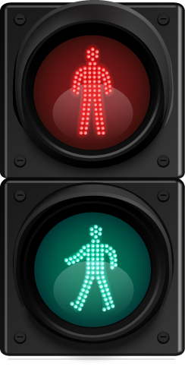
What are phrasal verbs?
English Language 2
Get over
Back up
Break down
Turn off
Take on
Look away
The difference between phrasal and prepositional verbs is whether the meaning of the verb is literal or symbolic.
What verbs do we choose when we want to say we’re using a particular public transport?
2025

Slide 5
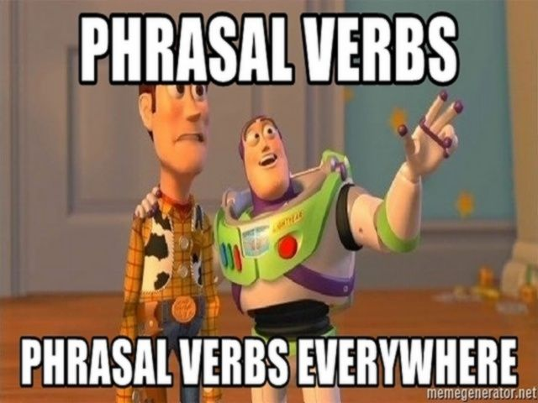
PHRASAL vs. PREPOSITIONAL verbs
 | Prepositional | Phrasal
Get over
Back up
Break down
Stand for
Look ahead
Take off
Make out
The child could not get over the fence to reach the ball.
Sarah could not get over her breakup.
He managed to back up his father’s car into a wall and break the bumper.
Nobody backed up the academic community for the general strike! ☹
My car broke down in the middle of the motorway.
Sarah broke down and cried when he told her he was leaving her.
We are standing for the free ice-cream.
Everyone must stand for their right to demand elections & peaceful assembly.
If you look ahead, you will see the Statue of Liberty.
Looking ahead, our company plans to open offices around the world.
It is customary to take off your shoes when entering a Slavic household.
Boris is really good at taking off politicians, it’s so funny.
I cannot make out who that is from so far away with no glasses.
Sarah saw him making out with his new girlfriend at the party.

Slide 6
Phrasal Verbs in Transportation
Get into – To enter a car
Ex. “We got into the car and drove to the nearest hotel.”
Get off – To exit a bus, train, or plane
Ex. “We got off the plane an hour ago, but got held up with finding our luggage.”
Get on – To enter, or board, a bus, train, or plane
Ex. “When the gates are closed, we can no longer get on the plane.
Back up – To move in the reverse direction
Ex. “Could you help me with backing up the van.”
OR to imply congestion.
Ex. “The traffic is starting to back up in this lane.”
Pull up – To stop a vehicle (often a car).
Ex. “The car pulled up by the passenger pick-up area.”
Pick up – To go someplace to get someone and provide them with transportation
Ex. “She needs to pick her friend up from the airport today.”
Hold up – To be delayed by something
Ex. “Sorry, we got held up by traffic on the way here.”
Drop off – To take someone to a place and leave them there
Ex. “He got here quickly because his dad dropped him off.”
See off – To be present at a departure area (i.e. bus station, airport terminal, or train station) and say goodbye to someone
Ex. “We’ll see you off before your move to Canada.”
If you don’t use a vehicle, you go on foot.

Slide 7
TYPES OF PHRASAL VERBS
With an object
Without an object
Phrasal verbs can also have both a particle and a preposition.
I can’t put up with my neighbour’s noise any longer!
If I’m late, you can go on without me and order food.
(look forward to, get along with, put up with, come down with, look up to...)

Slide 8
TYPES OF PHRASAL VERBS
Those with an object can sometimes be separated...
Sometimes they MUST be separated:
...but not always...
Those without an object can never be separated
She forgot to switch the computer off before going to sleep.
The end of this film always gets me down.
I can’t put up with my neighbour’s noise any longer!
We went over my contract at my new job before I signed it.
If I’m late, you can go on without me and order food.

Slide 9
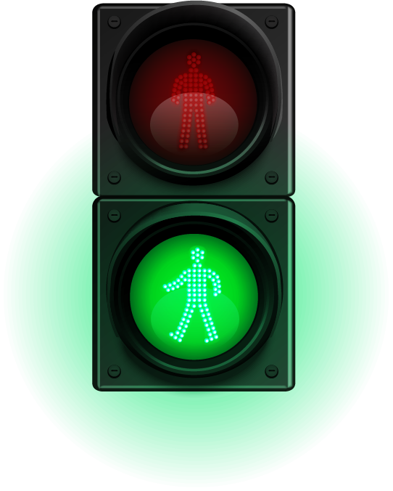
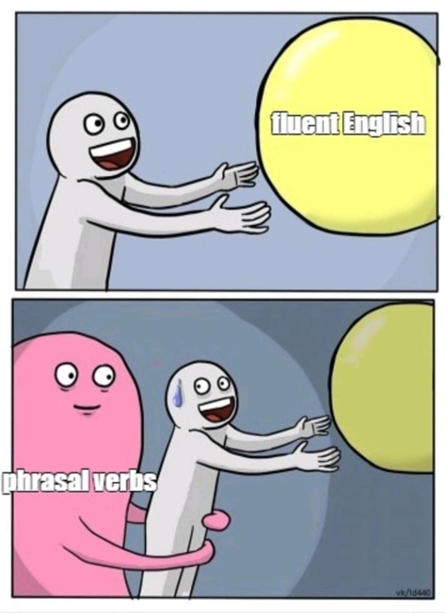
Phrasal Verb Practice
English Language 2
Grammar, page 41, exercise XIV
Grammar, page 42, exercise XVII
exercise XVIII
2025

Slide 10
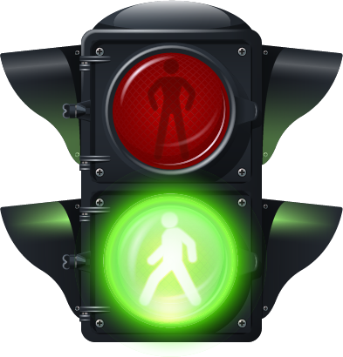
Some brain teasers with phrasal verbs
English Language 2
What kind of running means walking?
What do you throw out when you want to use it, but take it in when you don’t want to use it?
Four cars come to a four-way stop, all coming from a different direction. They can't decide who got there first, so they all go forward at the same time. They do not crash into each other, but all four cars go. How is this possible?
What goes through cities and fields, but never moves?
Which tire doesn’t move around when a car turns right?
Running out of gas
An anchor / life jacket
Right-hand turn / Roundabout
A road
The spare
2025

Slide 11
02
English Language 2
Emphasis on Quality and Efficiency
English in Transport and Traffic Engineering, Page 7
2025

Slide 12
emphasis
efficiency
Single European Market
competitive
logistics patterns
retail (groups)
distribution system
overseas
EC
EFTA
see the emergence
range of services
retailers
underway
slice of that cake
distribution hub
intermodalism
environmental considerations
isticanje
European Free Trade Association
efficacy – is it working?
effectiveness – is it working well?
efficiency – is it working well & quickly?
dovesti do pojave
jedinstveno tržište
razne usluge
konkurentno
maloprodajni objekti
model/organizacija (šablon/obrazac) logistike
u toku
udeo
maloprodajne grupe
sistem distribucije
sedište/centar/čvorište za distribuciju
kombinovani prevoz / intermodalizam
prekomorski/prekookeanski
European Community
pitanja životne sredine

Slide 13
boost
freight
freight traffic vs. passenger traffic
high speed passenger rail network
restrictions
road pricing
light rail
trunk road (network)
ease congestion
management of air space
meet the constantly growing air transport needs
airline
by-pass routes
hubs
maritime sector
National Dock Labour Scheme
trust ports
poboljšati
zadovoljiti sve veće potrebe vazdušnog saobraćaja
= cargo
teretni ≠ putnički saobraćaj
avio-kompanija
obilazni putevi
mreža brze putničke železnice
ograničavanja
centri/sedišta/čvorišta
naknada za korišćenje puteva (toll=putarina; pricing=tolls+congestion charges+VMT fees)
pomorski sektor
laka železnica
raspodela posla na dokovima/pristaništima
(mreža) magistralni put
povećati prohodnost, smanjiti zakrčenja/gužve
javne luke
port ≠ harbour port=infrastructure harbour can be natural
menadžment/upravljanje vazdušnim prostorom

Slide 14
Additional exercises
English language 2
Phrasal verbs are useful for cabin crew when asking passengers to comply with cabin crew instructions. Look at the situations and use the words in brackets to make polite requests.
1) Immigration form not filled in (use fill in):
Please, ______________________________
2) Tray table down (use put up):
Please, _______________________________
3) Infant not secure (use strap in):
Please, __________________________
4) Seat back reclined during landing (put up):
Please, __________________________
5) Baggage in aisle (put away):
Please, _______________________
6) Laptop turned on (switch off):
Please, ________________________________
2025

Slide 15
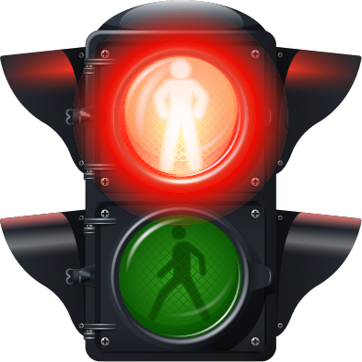
Additional exercises
II) Complete the sentences with the words in the box.
check out • keep up • stays up • get back • come in • get to • pass over
Exchange 1
ATC: Wolfair 60, good morning. Identified. Proceeding into Alba. Vectoring 05.
Pilot: Direct Alba 05. Wolfair 60. Can I _______ this high speed a bit longer? Wolfair 60.
ATC: Wolfair 60, for the time being, yes. I'll _______ to you in a minute.
Exchange 2
ATC: B67, will you let me know what your intentions are for the main landing gear?
Pilot: Roger. We'll try to lower the gear again, but if I'm still unable to release the nose gear - if it still ________ - then we'll land with all three up. B67.
ATC: B67, do you want to _______ for a low pass? We can _______ your landing gear when you _______.
Pilot: OK, roger. B67.
ATC: B67, have you got the field in sight?
Pilot: Affirm. When I _______ you the gear should be down. B67.
angular velocity
Air Traffic Control / Automatic Train Control

Slide 16
Additional exercises
III) Complete the sentences with the words in the box
off • on • up • down • back • around
1) Flight KLM 546 slow ______ ! You are taxiing too quickly.
2) My flat tyre made the steering unresponsive. I almost skidded ___ the runway.
3) Tug 4, you'll have to go _______ to stand 17 and assist SAS 418.
4) Ground Control Bus 4. Acknowledge stand change. Turn ________ and proceed to stand 13.
5) Gulf Alpha Bravo Lima, permission to carry ______ past the stationary 757.
6) China 412 pick up a little speed and catch _____ with the Airbus ahead of you.

Slide 17
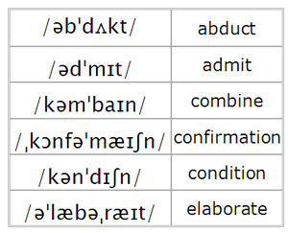
ICAO spelling Alphabet (International Civil Aviation Organisation)
A - Alfa
B - Bravo
C - Charlie
D - Delta
E - Echo
F - Foxtrot
G - Golf
H - Hotel
I - India
J - Juliet
K - Kilo
L - Lima
M - Mike
N - November
O - Oscar
P - Papa
Q - Quebec
R - Romeo
S - Sierra
T - Tango
U - Uniform
V - Victor
W - Whiskey
X - X-ray
Y - Yankee
Z - Zulu

Slide 18
Discussion
What are you looking forward to these days?
When something is broken in your home, who sorts out the problem?
When something is difficult, do you give up easily?
If someone cuts you off when you’re in the middle of a sentence, do you get annoyed?
What signs tell you that you might be coming down with a cold?
Where do you usually hang out with friends?
How often do you work out? What exercises do you do?
Who is someone in the world that you look up to?
What do you look for in a romantic partner? Good looks? Intelligence? Something else?
If your friends were feeling sad, how would you cheer them up?
Which events or activities do you dress up for?
Is it easy to get along with everyone? Or are some people too hard to get along with?
How can a person get over heartbreak quickly?
Who usually took care of you when you were a child?
Which of your parents do you take after more?
How do you think the EU influences traffic and transport?
How do you think our traffic infrastructure would change if we joined the EU?
What is the main cause of congestion in Belgrade? In Serbia? In Europe?
What could we do to ease congestion on roads in Belgrade?
Do you think road pricing would be a good option? Why/why not?
Do you think our air traffic is also congested? How can we see that?
What can we do to improve air traffic congestion?
Have you ever heard of the ICAO alphabet? How much did you know about it?
How practical is our intermodal transport? How can we improve it?

