Slide 1
Ship Parts and Adverbs

Slide 2
Lesson Plan
01
02
Grammar: Adverbs
Grammar exercises
03
04
Vocabulary: Ship Parts
Vocabulary exercises and Discussion

Slide 3
Adverbs

Slide 4
What do they modify?
Verbs
Nouns
That car can go quickly.
The above sentences are all about fast cars.
Adjectives
Phrases
It is a very fast car.
The car is almost halfway across the bridge.
Adverbs
Sentences
She drives too fast.
Fortunately, she drives well.

Slide 5
What do they signify?
Manner
Quantity
Time
Degree
Frequency
Probability
Place
Though she drives quickly, she drives well.
If he had a car, he would drive everywhere.
After much planning, the party was very fun.
Affirmation
You have to wake up early tomorrow.
She drives too quickly.
She will surely end up in jail if she keeps driving like that.
Negation
He would go out more frequently if he had a car.
Perhaps we can go on a cruise?
We will never go on a cruise.

Slide 6
Adjectives vs. Adverbs
With linking verbs, we use adj, not adv! (be, see, feel, smell...)
Can I please leave the lecture, I feel really
Because of the burn on her hand, her sense of touch isn’t so good, and she feels
BAD
BADLY
Ever since he got a cold, he has smelled
One particular charm of public transport is that during winter most people smell
BADLY
BAD

Slide 7
Adjectives vs. Adverbs
Fast
Hard
Sometimes the adjective and the equivalent adverb are the same (no –ly)
Lamborghini Diablo is a fast car. The car goes very fast.
This is a hard question. I am working hard.
NOT: I am hardly working!

Slide 8
Sometimes the adverb = adjective, and either can be used.
The moon is shining bright / brightly.
She is sleeping sound / soundly.
Sometimes the adverb and adjective have completely different meanings.
Late(ly)
They were late to work because of the traffic. / Sarah has been sad lately.
High(ly)
The airplane is high in the air. / He is highly appreciated at work.

Slide 9
Grammar exercises:
Grammar, exercise XXXIII

Slide 10
Ship Parts
03

Slide 11
hull
superstructure
trup broda
nadgrađe
machinery
ancillary
mašine
pomoćno
shell of the ship
winches
brodska oplata
vitla
vessel
plovilo

Slide 12
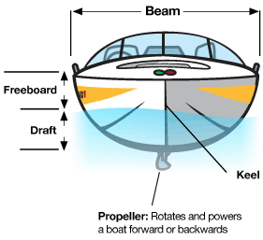
stern (aft(er) end)
amidships
krma (zadnji kraj)
sredina broda
astern
beam
unazad
glavno rebro
bows (fore end)
keel
pramac (prednji kraj)
kobilica

Slide 13
engine room
passenger liner
mašinski prostor
Putničko linijsko plovilo
funnel
propeller shaft
dimnjak
Pogonska/propelerska osovina
shipping line
shaft tunnel
brodska kompanija
tunel p. osovine
windlass
čekrk

Slide 14
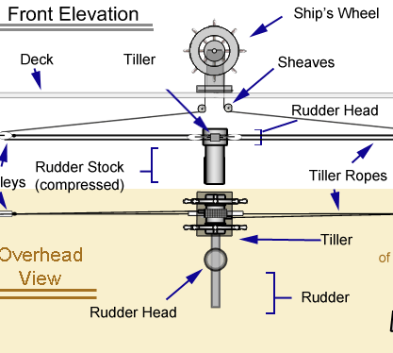
propulsion unit
heavy seas
pogonska osovina
nemirno (uzburkano) more
rudder
high seas
kormilo
otvoreno more
stabilizers
bulbous bow
stabilizatori
obli (gomoljast) pramac
rolling
pitching
valjanje/ljuljanje
propinjanje

Slide 15
turn-round time
in ballast
vreme utovara/istovara
pod opterećenjem
deck
holds
paluba
tovarni prostor
’tween decks
cargo handling
dvopalubni brod
shelter deck
rukovanje teretom
međupaluba
consignment
isporuka/pošiljka

Slide 16
Types of Ships
tugs
tramps
tegljači, remorkeri
tramper,
nelinijski teretni brod
container ships
tankers
brod kontejner, kontejnerski brod
tankeri; brod za prenos tečnih tereta
cargo liner
bulk carriers
linijski teretni brod
brodovi za prevoz rasutih tereta
barges
barže

Slide 17
lifting apparatus
quay(-side)
oprema za podizanje
kej, pristanište
derricks
bridge of a vessel
brodska dizalica
komandni most
lifting capacity
helm
kapacitet (po)dizanja
kormilarsko kolo, kolo kormila
masts
radio direction finder
jarboli
radiogoniometar

Slide 18
Let’s revise ship parts.
Quiz time!
3.5

Slide 19
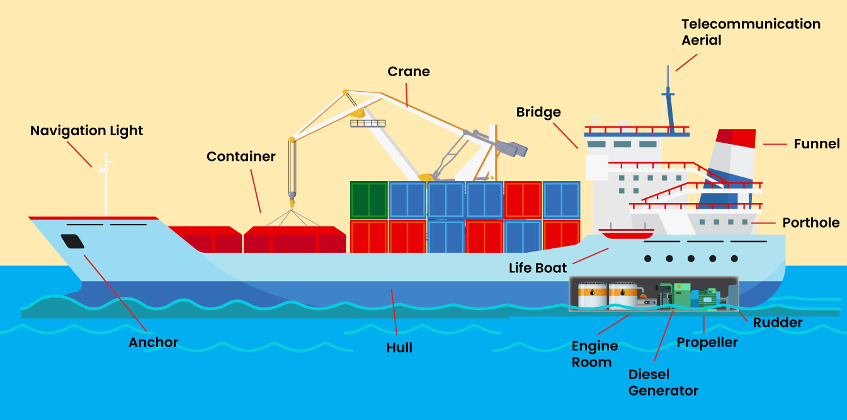

Slide 20
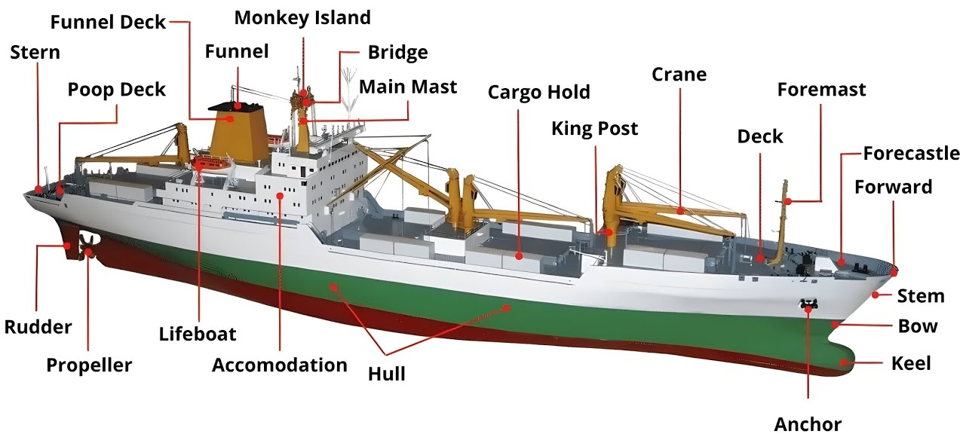

Slide 21
04
Discussion

