Slide 1
Adjectives & Comparison + Roundabout Safety

Slide 2
Table of contents
01
02
03
Adjectives and their comparison
Grammar exercises
Roundabouts: Reducing Traffic Frustration
04
Discussion

Slide 3
01
Adjectives and their comparison

Slide 4
What do adjectives do?
Adj modify nouns, even if they do not stand right next to them.
Green light means you can cross the street. = Now, the light is green.

Slide 5
Word order
A beautiful, small, new, square, silver, Italian, x city car.
Size
Shape
Nationality
Purpose
01
02
03
04
05
06
07
08
Opinion
Age
Colour
Material

Slide 6
Degrees of Adjectives
Absolute
Comparative
Superlative
(„pozitiv“)
cold
happy
narrow
important
good
(„komparativ“)
cold + -er
happy + -ier
narrow + -er / more+
important + more
good better
(„superlativ“)
THE +
cold + -est
happy + -iest
narrow + -est / most+
important + most
good best

Slide 7
The Comparative
NICE
SAFE
COLD
DRY
COOL
Short adj (1 syllable)
R
R
If adj ends in –e, we just add –r. If not, add –er.
ER
–IER
ER
Medium adj (2 syllables)
MORE
AWFUL
RIGID
LIKELY
Some adj take –er,
Others need more + absolute
Some can take on either (not both)
MORE
ER
MORE
–IER
Long adj (3+ syllables)
BEAUTIFUL
IMPORTANT
MORE
More + absolute

Slide 8
The Superlative = THE + ?
Short adj (1 syllable)
ST
NICE
SAFE
COLD
DRY
COOL
ST
THE
If adj ends in –e, we just add –st. If not, add –est.
EST
–IEST
Medium adj (2 syllables)
EST
PSA: irregular adjectives also exist:
Good, bad, little, far...
MOST
AWFUL
RIGID
LIKELY
Some adj take –est,
Others need most + absolute
Some can take on either (not both)
THE
MOST
EST
MOST
–IEST
Long adj (3+ syllables)
BEAUTIFUL
IMPORTANT
THE
MOST
Most + absolute

Slide 9
Adjectives vs. Adverbs
With linking verbs, we use adj, not adv! (be, see, feel, smell...)
Can I please leave the lecture, I feel really
Because of the burn on her hand, her sense of touch isn’t so good, and she feels
BAD
BADLY
Ever since he got a cold, he has smelled
One particular charm of public transport is that during winter most people smell
BADLY
BAD

Slide 10
02
Grammar exercises
Page 58, exercise XXIX

Slide 11
03
Roundabouts: Reducing Traffic Frustration

Slide 12
Roundabout
Yield-at-entry (roundabout)
(raskrsnica sa) kružnim tokom
kružni tok sa ustupanjem prvenstva na ulazu
Right of way
Download
pravo prvenstva prolaza
preuzeti
Construction
Operational element
izgradnja
radni element

Slide 13
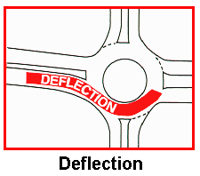
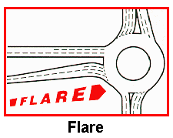
Deflection of the vehicle path
skretanje putanje vozila
Entry flare
dodatna traka za ulazak u raskrsnicu

Slide 14
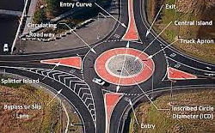
Splitter islands
Sight distance
razdelna ostrva
dužina preglednosti
Central island
Signing
središnje (razdelno) ostrvo
Signalizacija (obaveštavanje i upozoravanje učesnika u saobraćaju)

Slide 15
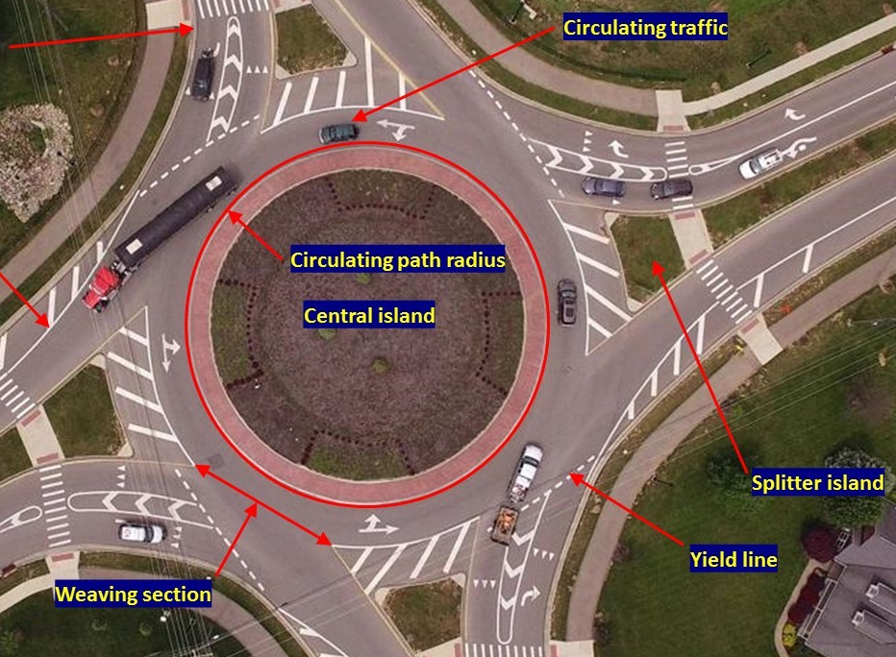
(length of) weaving section
dužina ulivanja
(Truck) apron
rulna staza (za kamione)
Yield lines
Oznake na kolovozu (za ustupanje prava prvenstva prolaza)

Slide 16
Tangent approach
tangentni prilaz
Perpendicular direction
upravni pravac / pravac kretanja pod pravim uglom
Alleviate (congestion)
Umanjiti/ublažiti (zakrčenost)
Capacity (of a roundabout)
Propusna moć/propusnost (kružnog toka)

Slide 17
Exercise 01: Complete
It is crucial to respect the __________ to ensure safety on the roads.
The use of __________ is that they prevent left turns and make drivers reduce their speed.
The main point of the __________ rule is to give up your _______ when entering a roundabout.
To ensure easier entry into a circular intersection by splitting the entry into several lanes, engineers constructed the ___________.
The angle at which the car approaches a roundabout is called the __________ angle.
That angle used to be non-existent, since old, initial roundabouts used to have __________ approaches, which did not encourage speed reduction.
Yield at entry
Entry flare
Deflection
Splitter islands
Tangent
Traffic rules
Right-of-way

Slide 18
Discussion time

