Slide 1
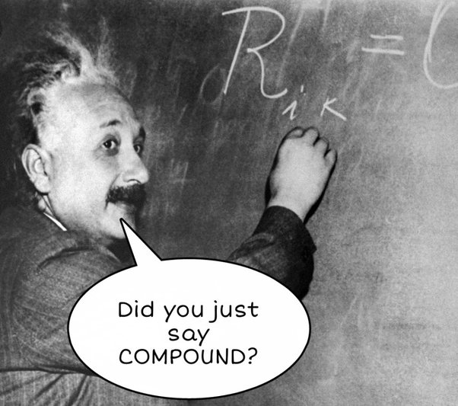
COMPOUND NOUNS

Slide 2
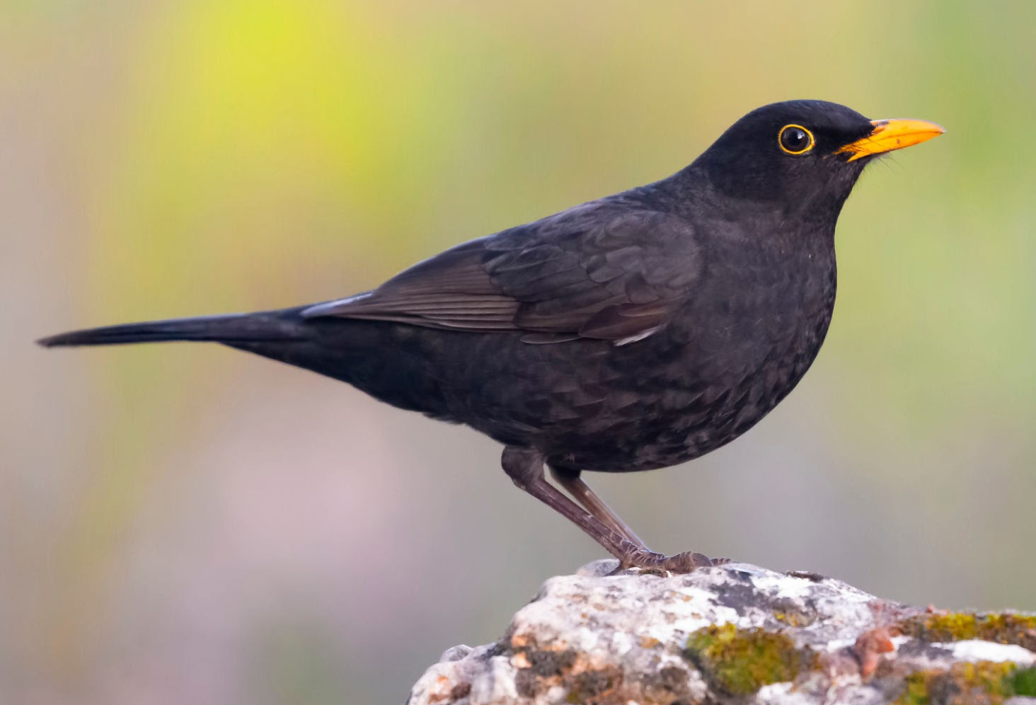
What are compounds?
Words that consist of multiple units that have a different meaning (non-literal) than those units put together:
When understanding compounds, different parts of our brains process them than some other random word groups.
Difficult to safely determine where collocations stop and compounds begin.
black bird vs. blackbird
housewife vs. unfaithful wife
golden child vs. golden bracelet

Slide 3
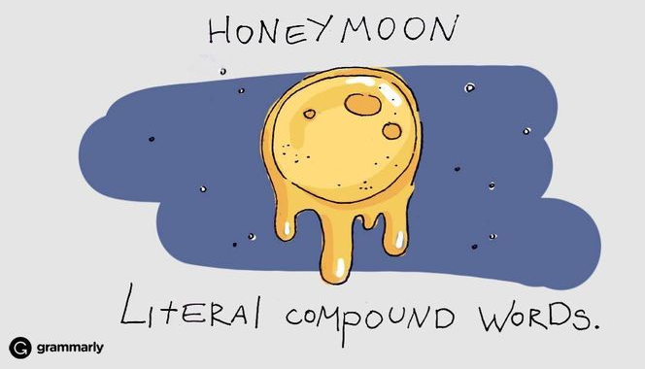
How to make a compound?
In English, compounds can be anything: N+N, Adj+N, N+Adj, Adj+Adj, V+Prep, etc.
When we have a cluster of nouns and prepositions – it can be made shorter via compounding
Can be written as one word / with a hyphen / two words.
engineer for traffic
flying speed
footloose
credit card
takeout
mother-in-law
check-in
blackbird

Slide 4
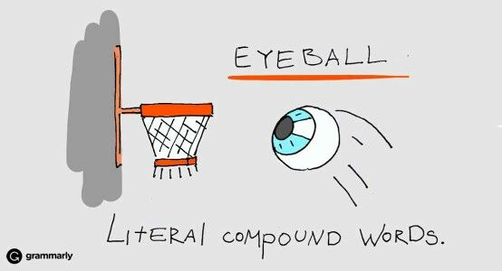
The structure of compounds
The word order is also important in compounds!
Therefore, whichever word comes last is the most important (vs. in Serbian, where the first is most important:
Plural: add –s to the last word in the compound!
car battery vs. battery car
high-speed passenger rail network -
mreža
brze
putničke
železnice
s
s
s
s
Two-hour flight
s
90 horse -power engine
cable management
s
s

Slide 5
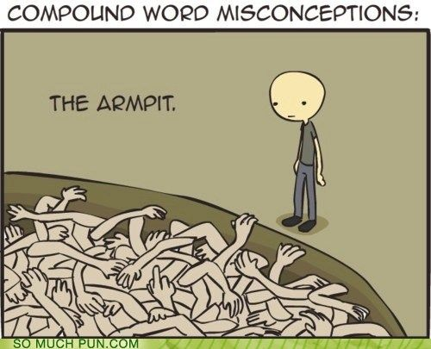
practical exercises
Grammar, page 47: exercise XXI
Grammar, page 48: exercise XXII

Slide 6
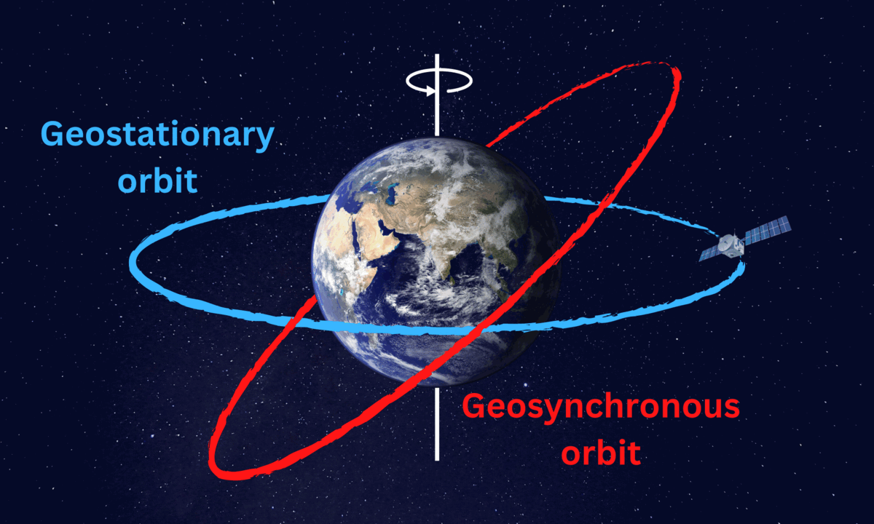
Satellites
GEO:
Geostationary
Geosynchronous
NGSO:
MEO
LEO

Slide 7
SATELLITES

