Slide 1
Welcome to English 1!

Slide 2
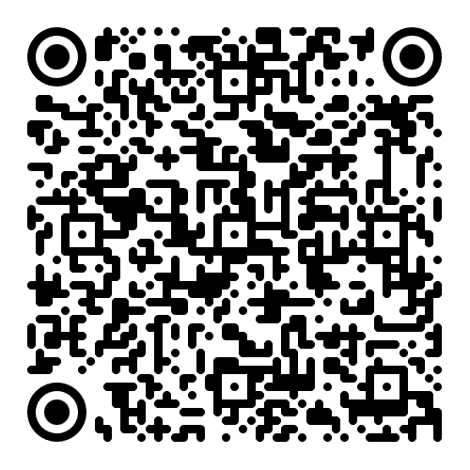
Introduction
E-mail: s.stefanovic@sf.bg.ac.rs
Consultation hours: Thursdays 15h-16h (room 05)
Please sign up in the list, and let me know if you decide not to attend after the two-week trial period!

Slide 3
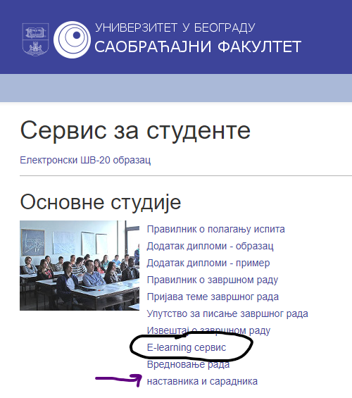
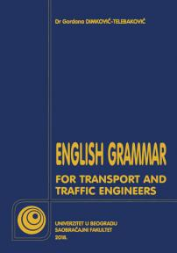
In case you do opt for English 1...
Moodle: nastava.sf.bg.ac.rs
Student books:
Do not forget to sign up for the subject electronically! Do not forget to apply for the exam electronically!

Slide 4
Exam structure
Written Exam: 80 points + Oral Exam: 20 points
colloquium 1 (45 points) – held in November during class
Written Exam colloquium 2 (35 points) – held during regular exam terms
Oral Exam in-class activity (10 points)
oral exam (10 points) – choose one of the text we’ve covered, and send in a recorded speech on that topic to my email before the exam (format: youtube or google drive; duration: 5 minutes)

Slide 5
Exam Structure & Goals
The list of all units covered will be posted to Moodle
Extreme importance of applying for the exam AND having your final mark signed into your booklets!
The aim of English courses (ESP):
To familiarise students with the terminology for Transport and Traffic Engineering
To facilitate a fluent, accurate usage of the foreign language
To enable students to use the language more freely in everyday communication
To understand and be understood by native speakers

Slide 6
The English Alphabet

Slide 7
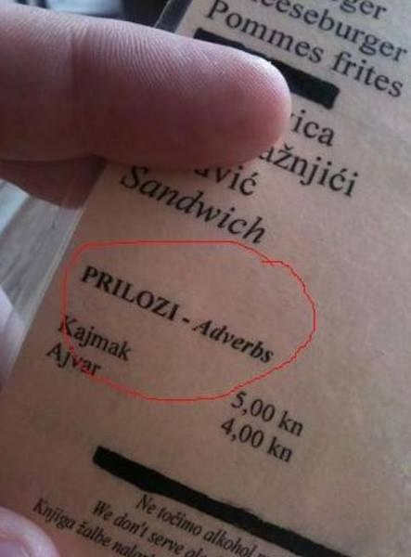
Vrste reči = Parts of Speech
Nouns
table, book, car, Ana, Earth, confusion, anger, fear, student...
Imenice
Zamenice
Glagoli
Brojevi
Pridevi
Prilozi
Predlozi
Veznici
Članovi
Pronouns
I, you, me, mine, yours, himself, everyone, anybody
Verbs
to love, worked, talking, had done
Numbers
thirteen, first
Adjectives
sociable, introverted, fun
Adverbs
slowly, kindly, beautifully
Prepositions
in, into, at, out, above, below
Conjunctions
and, despite, but
Articles
a, an, the

Slide 8
Context is everything!
I have red shoes. vs. I love red.
Activity for next time:
Learn how to spell your full name!

Slide 9
Traffic vs. Transport
Traffic refers to the movement of vehicles, goods, or people (pedestrians) in an area that uses infrastructure as a means of travelling from place to place. It could refer to cars moving along roads and highways, aircrafts flying in and out of airports, ships moving along charted routes, and so on.
Transportation (transport) is the system or means by which creatures or objects are moved from one place to another using modes such as road vehicles, trains, aircraft, ships, and so on.

Slide 10
Thank you for your attention.

