Slide 1
Modal verbs

Slide 2
What are modal verbs?
Speaker’s attitude towards the world:
Likelihood, ability, permission, request, suggestion, order, obligation, necessity, possibility, advice
Attitude ≠ Facts:
Distance from the factuality of the statement

Slide 3
Modal verbs
BASE FORM | DISTAL FORM
WILL
SHALL
CAN
MAY
MUST
WOULD
SHOULD
COULD
MIGHT
HAVE TO

Slide 4
WILL vs. WOULD
Possible future Determination, plan Command Promise Threat | Past tense of will (indirect speech, II and III conditional) Habits in the past Desire Likelihood
I think I will order the pasta.
She said she would visit on Saturday. If you (had) studied, you would (have) pass(ed) the exam.
He will pay his speeding ticket today.
At my old job, I would work until 10pm.
You will eat your veggies and you will like them!
She would like to learn English.
We’ll go to the park when you do your homework.
You would think so, but actually it’s not true.
You will pay for this!

Slide 5
shaLL vs. shOULD
Possible future Determination, plan Command Promise Threat | Past tense of shall (indirect speech) Obligation, strong advice Inverted first conditional Likelihood
Shall we leave?
She asked if we should leave.
This paper shall examine city logistics.
You should do as I say.
You shall do as I say, or else!
Should you study, you’ll pass the exam.
He shall go when his mother gets home.
They should be here any minute now.
You shall pay for this!

Slide 6
can vs. cOULD
Ability, capability Permission Possibility / impossibility Request | Ability, capability in the past Permission in the past Possibility / impossibility (less certain) More polite request
Can you ride a bicycle?
He could speak French fluently when he was young.
You can’t smoke in here.
I couldn’t smoke at the restaurant.
Driving in Belgrade can be nerve-wracking.
She couldn’t have done such a horrible thing!
Can you close the door, please?
Could you close the door, please?

Slide 7
may vs. might
Request Permission Possibility / future possibility Prohibition Wishes | Request in the past / more polite Permission in the past / more polite Possibility / future possibility (less certain) Doubt
May I see them in my office?
I asked if I might see../Might I see you for a minute?
You may leave now.
He asked if he might leave/Might I make a suggestion?
The news may be true. / It may rain today.
I thought I might travel by car / It might rain.
Children may not step on the lawn.
She might pass her exam, or she might not.
May all your dreams come true!

Slide 8
must vs. Have to
Command, obligation Logical conclusion Logical necessity Prohibition Strong advice | Command, obligation Logical conclusion Logical necessity
In England, traffic must be kept to the left.
You have to wait in queue 5 feet behind the person in front of you.
You must be tired.
It’s late, so I guess we have to go.
I suppose I must go to my cousin’s wedding.
You have to work hard nowadays to make a living.
The difference between the two is the source of obligation! Internal = MUST External = HAVE TO
You mustn’t leave your luggage unattended.
You must come visit! You mustn’t be too sad!

Slide 9
Additional modals: need, dare
Need: Similarly to have to, used for obligations, necessities, and logical conclusions
Needn’t have vs. Didn’t need to:
You needn’t have bought me a present. You didn’t need to buy me a present.
Dare: Don’t you dare look away while I’m presenting our research.
He needs to take his medicine as soon as possible.
... But you did anyway!
... And it’s good that you didn’t!

Slide 10
Additional semi-modals: ought to, used to
Ought to: more dramatic than should; advice, obligations, duties
Used to:
You really ought to listen carefully. / I ought to punch him for what he said to me!
I used to be good at football, but then I broke my knee cap.
BUT!
When did you USE to play football?

Slide 11
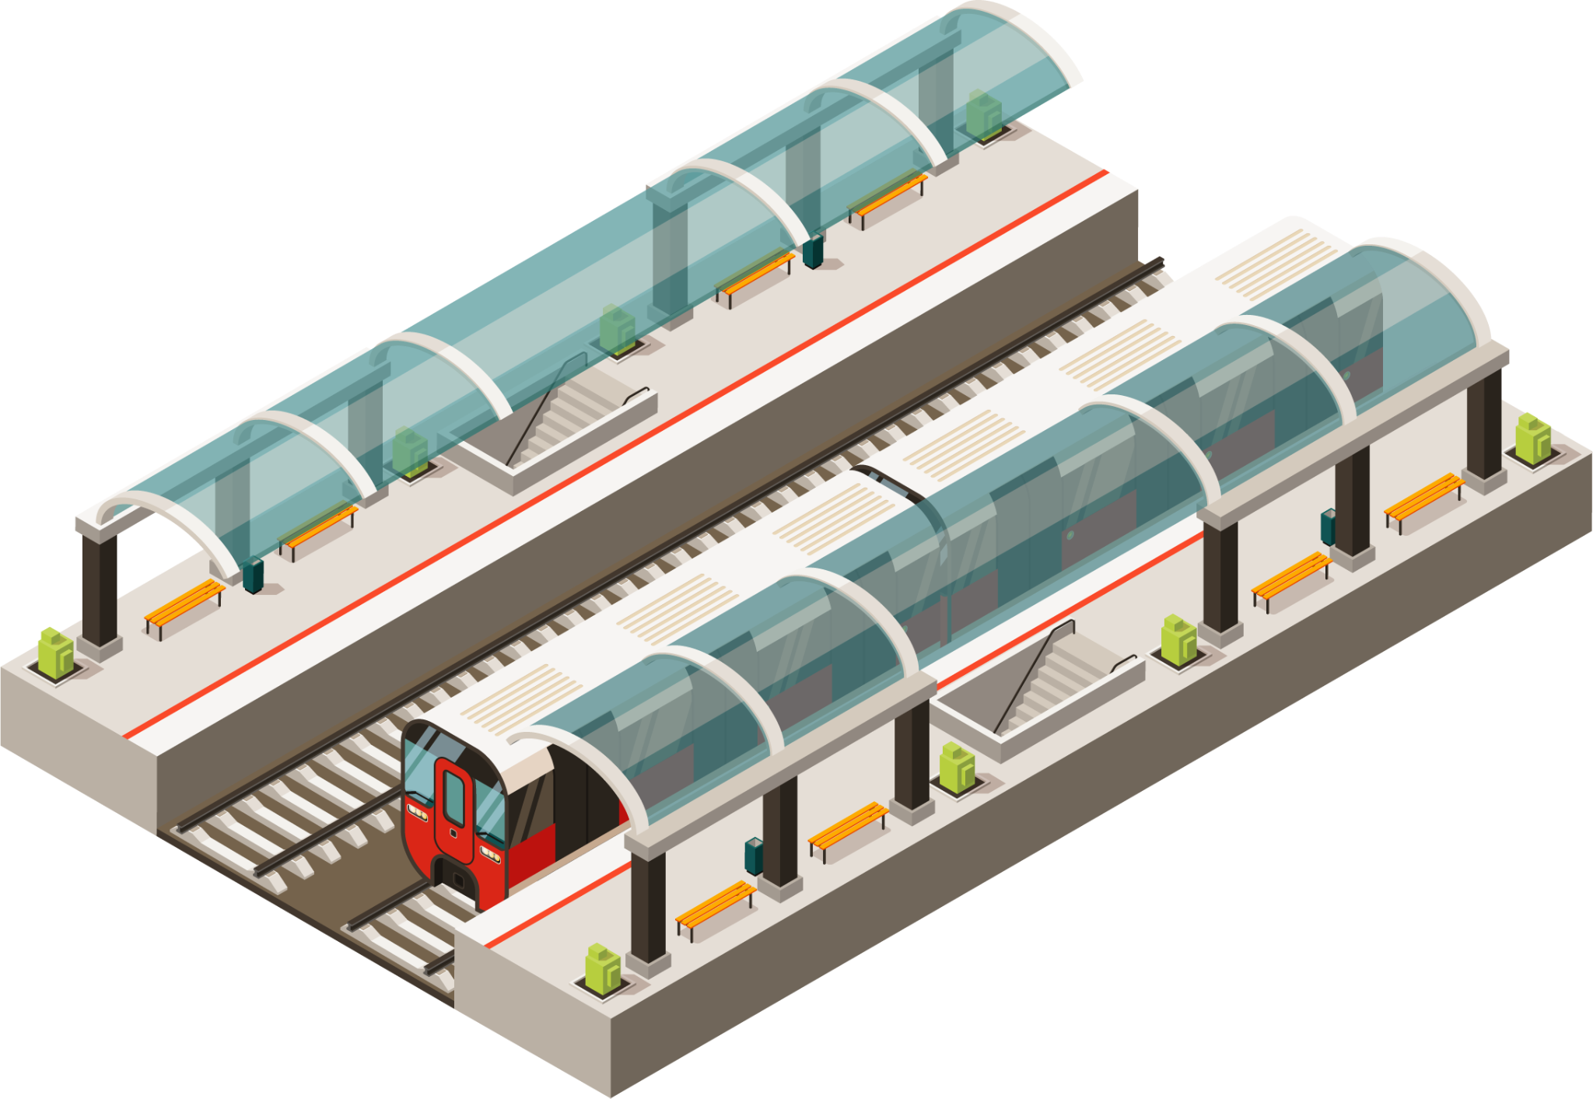
Practical exercises
Grammar:
page 38, exercise XI and XII
Testovi:
Page 9, sentence 1, 3, 5 (translation) + 4
Page 10, sentence 2 (translation)
Page 15, sentence 2
Page 18, sentence 1
Page 21, exercise IX sentence 1
Page 23, sentence 5 (translation)
Page 25, exercise IX sentence 1
Page 26, sentence 4 (translation)
Page 30, exercise VI sentence 1
Page 39, sentence 3 (translation)
Page 45, sentence 4
Page 50, exercise VII sentence 1
Page 68, exercise IX sentence 1, 3, 4

Slide 12
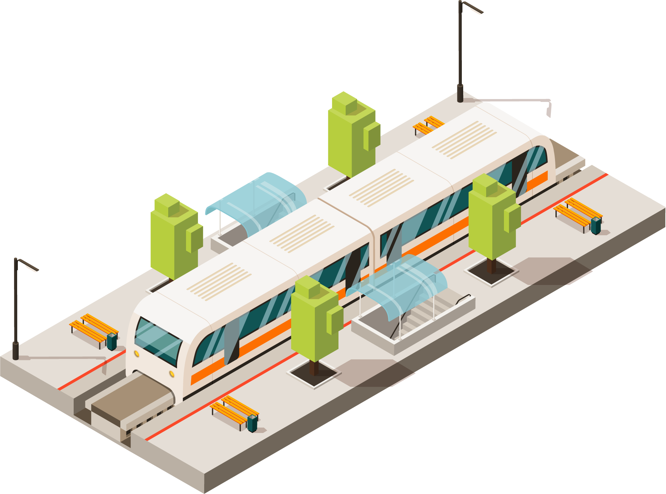
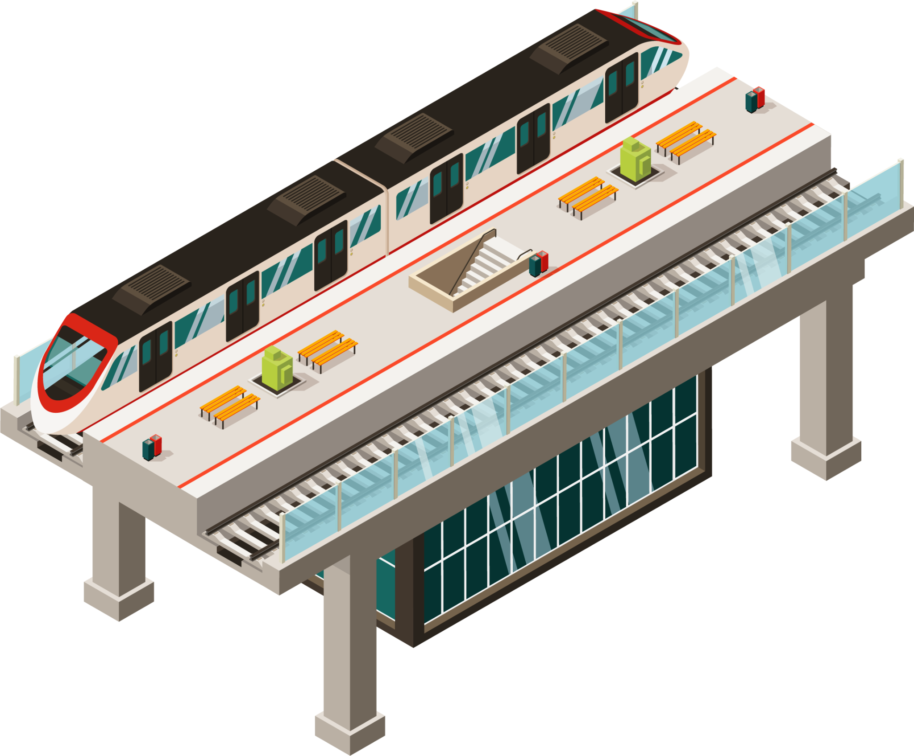
Japanese trains
April 1994, page 6

Slide 13
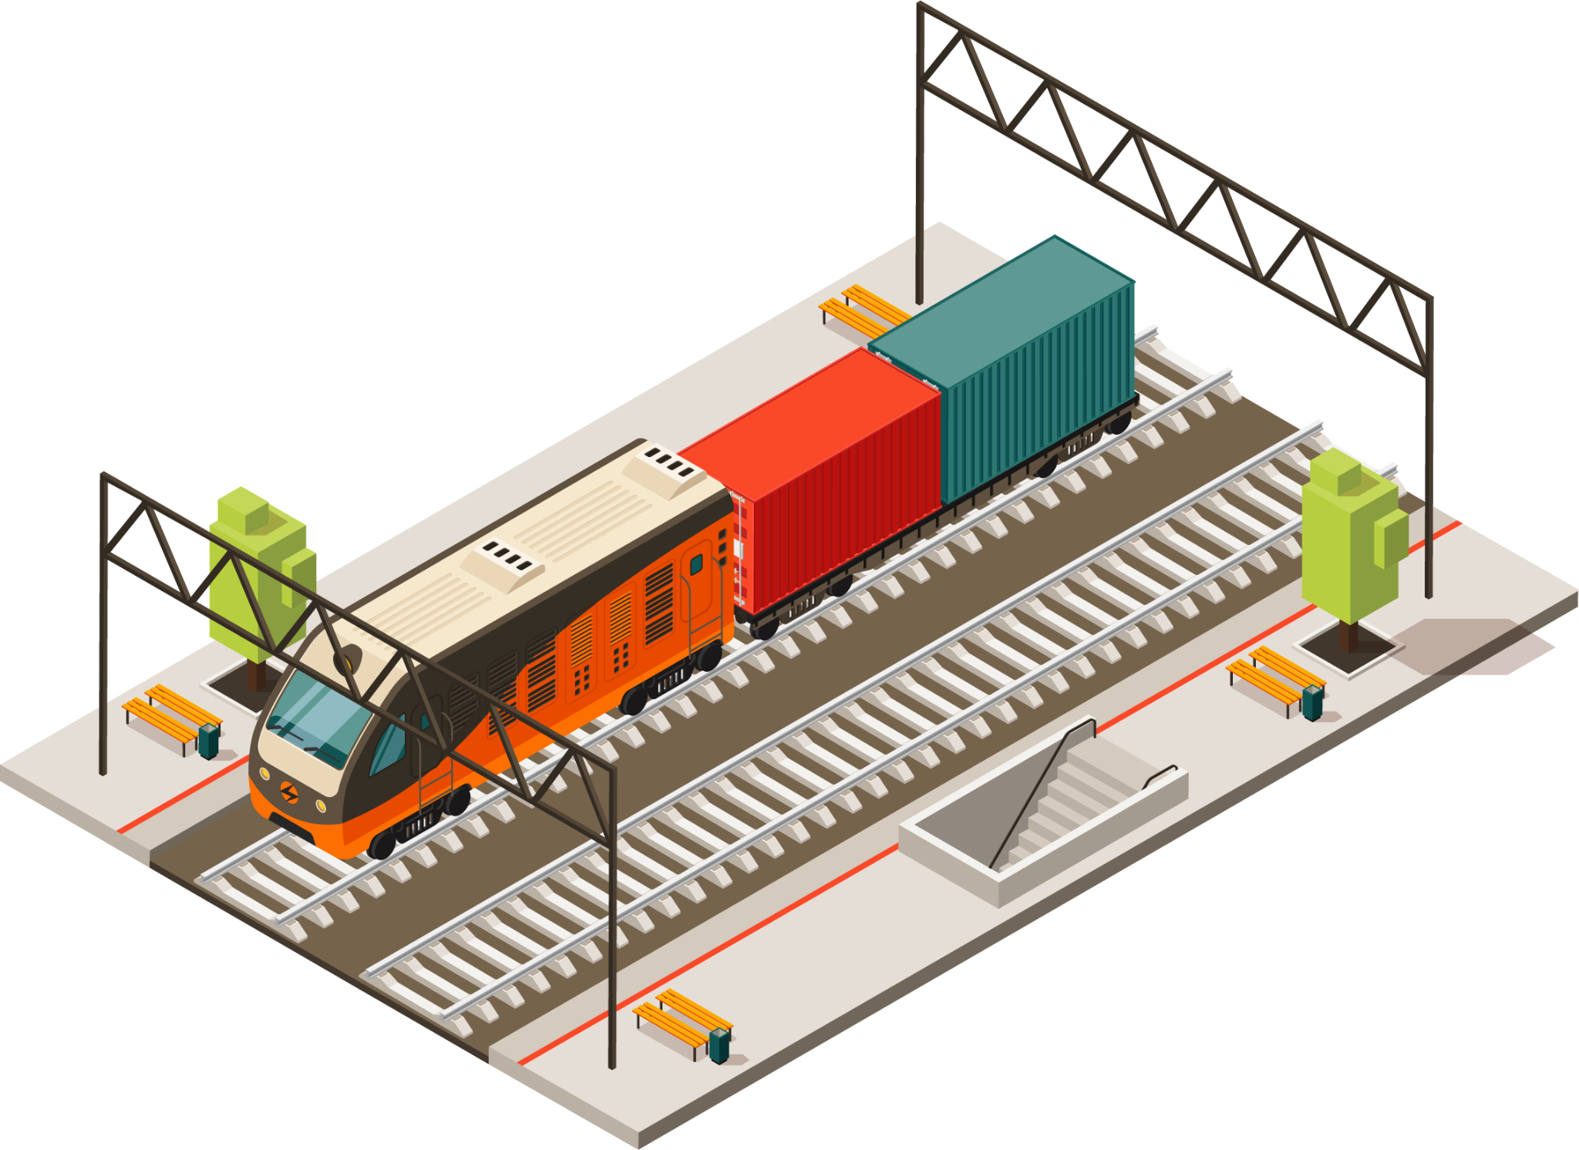
commence revenue service
high-speed running tests
recorded speed
EMU
designed to operate
test run train
modified (for high speeds)
gear ratio of driving gear
počnu sticati prihode od usluga
testovi/ispitivanja pri velikim brzinama
zabeležena brzina
Electric Multiple Unit (elektromotorni)
projektovan da saobraća
probni voz
prilagođen velikim brzinama
stepen prenosa na zupčanicima

Slide 14
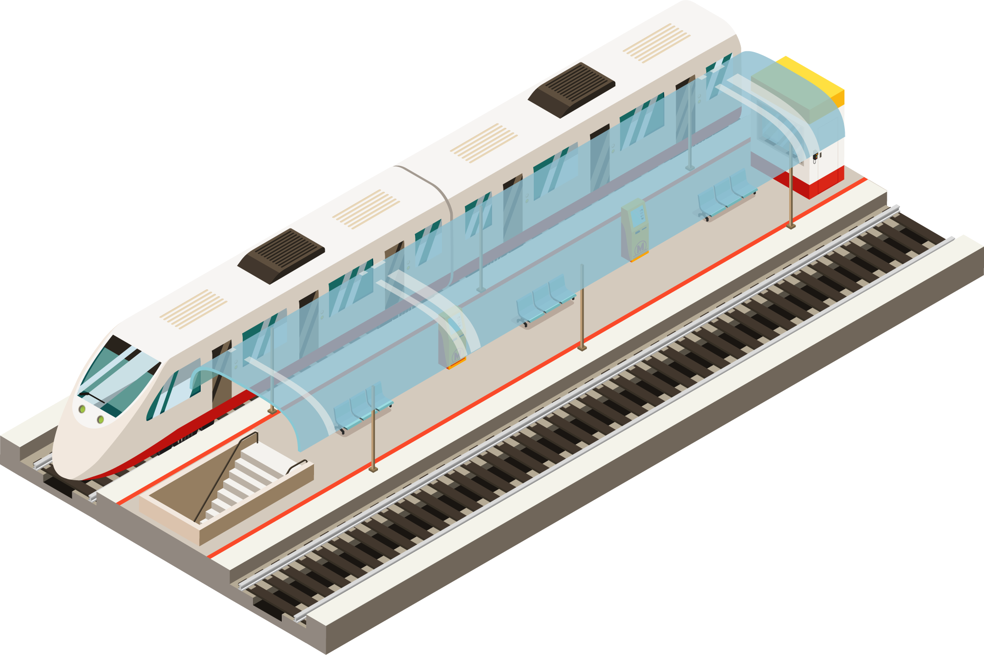
tractive effort, traction
wheel sets
weak field control
traction motor circuits
braking deceleration
heat capacity of brake disc
ATC
higher speed signal steps
vučna snaga, vučna sila
točkovi
niskonaponska kontrola
pogonska vuča
sila kočenja
kapacitet zagrevanja disk kočnica
ATC uređaj (za automatsko vođenje voza)
promena velikih brzina

