Slide 1
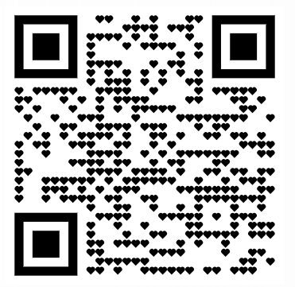
English language 2

Slide 2
Welcome to english 2
E-mail: s.stefanovic@sf.bg.ac.rs
Consultation hours: Mondays 13h-14h (room 05)
Moodle: nastava.sf.bg.ac.rs
Do not forget to sign up for the subject electronically! Do not forget to apply for the exam electronically (both exam terms)! If you do not have your E1 grade signed – apply for English 1 exam as well.

Slide 3
In case you do opt for English 1...
Student books:

Slide 4
Exam Structure:
Written Exam: 70 points + Oral Exam: 30 points
Reading Comprehension (10 points) – held in April during class (and during regular exam terms)
Written Exam Written Test (60 points) – held during a pre-term, and during regular exam terms
Oral Exam in-class activity (10 points)
oral exam (20 points) – choose one text from the book, and send in a recorded speech on that topic to my email before the exam (format: YouTube, Google Drive, WeTransfer; duration: 5 minutes)

Slide 5
articles
A, AN, THE

Slide 6
The definite article - the
For specific things, or when the identity of something is known.
To say there is only one of something, or to refer to every single unit of something.
The hamburger was invented in Hamburg.
The Queen died two years ago.
Our planet revolves around the Sun.
Dad, can I borrow the car?
The wolf is a beautiful animal.

Slide 7
The definite article - the
With adjectives in the superlative and ordinal numbers.
When something was already mentioned previously.
For systems or services:
What is the most efficient means of public transport? Marie Antoinette’s husband was Louis XVI.
This is the song I was telling you about.
I saw a cat in the street. The cat was orange.
He takes the train to work / I heard the news on the radio.

Slide 8
The definite article - the
Before nationalities.
Before the names of families.
Before musical instruments
The Irish are known for their love of alcohol.
The Martins are coming over for dinner.
She plays the violin.

Slide 9
The definite article - the
Before geographic notions: rivers, mountain chains, lakes, seas.
Before the names of plural countries.
Before theaters, museums, hotels, etc.
We crossed the Danube on a barge. I was skiing in the Alps. (vs. I went to Zlatibor)
He spends every summer at the Mediterranean.
The United Kingdom was the first to introduce roundabouts.
I will meet you at the National Museum / the Radisson.

Slide 10
The definite article – when to avoid it?
When something was already specified, or when only one exists:
Before cities and singular countries: (exception: the Hague)
Before palaces, bridges, quares, parks, stations, and airports:
Turn your books to the page 5. The Queen died. ≠ The Queen Elizabeth died.
They live in the London. I really wish to visit the Egypt.
We will land at the Heathrow soon. She saw it all:the Buckingham Palace,the London Bridge,the Piccadily and the Trafalgar Square.

Slide 11
The definite article – when can we both use it and not use it?
With certain institutions, with a slight difference in meaning:
With famous people, for emphasis:
They go to church every Sunday ≠ They go to the church every Sunday.
I was in hospital the entire night ≠ I was in the hospital the entire night.
He went to college ≠ He went to the college.
You’re Johnny Depp? ~ You’re THE Johnny Depp?

Slide 12
The indefinite article: a / an
When something is unspecified (can be replaced with some)
When something is mentioned for the first time
When something is not one of a kind, but just one of many (any)
There’s a man at the door.
There is a book on the table.
He was going down the street when he saw a sign.
A cow can give milk.
Hello, I would like to buy a hat.

Slide 13
One practical exercise
English Grammar for Transport and Traffic Engineering
page 54
exercise XXVII (fill in the blanks)

