Slide 1
Word order
What do? How inversion? Why grammar?

Slide 2
Declarative sentences.
Subject (who?)
Predicate
Object (what?)
Manner (how?)
Place (where?)
Time (when?)
the problems of public transport
The passenger network
quickly and efficiently
in and around large conurbations
since it was established
has been handling

Slide 3
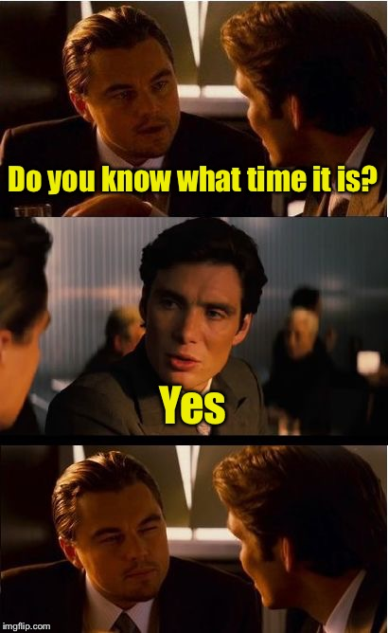
Interrogative sentences: yes/no questions
Modal / Auxiliary verb
Subject
[the rest of the predicate]
Object
Adverbs
place, time, manner etc.
Was Elizabeth / the Queen in 1994?
crowned
Can Howard speak English fluently?

Slide 4
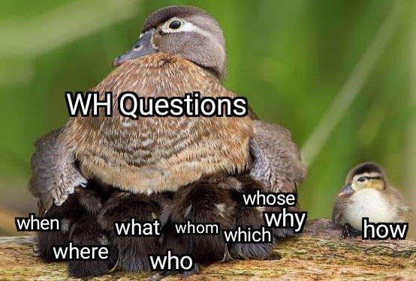
Interrogative sentences: wh- questions
Interrogative pronoun (who, what, where, why, when, how)
Verb (auxilliary / modal)
Subject
Predicate
Adverbs
place, time, manner etc.
I drive my car alone to work every day. – for objects
What do you drive alone to work?

Slide 5
Interrogative sentences: wh- questions
Interrogative pronoun (who, what, where, why, when, how)
Verb (auxilliary / modal)
Subject
Predicate
Adverbs
place, time, manner etc.
Object
I drive my car alone to work every day. – for objects’ possession
Whose car do you drive alone to work?

Slide 6
Interrogative sentences: wh- questions
Interrogative pronoun (who, what, where, why, when, how)
Verb (auxilliary / modal)
Subject
Predicate
Object + Adverbs
place, time, manner etc.
I drive my car alone to work every day. – for adverbs
How/where/when do you drive your car?

Slide 7
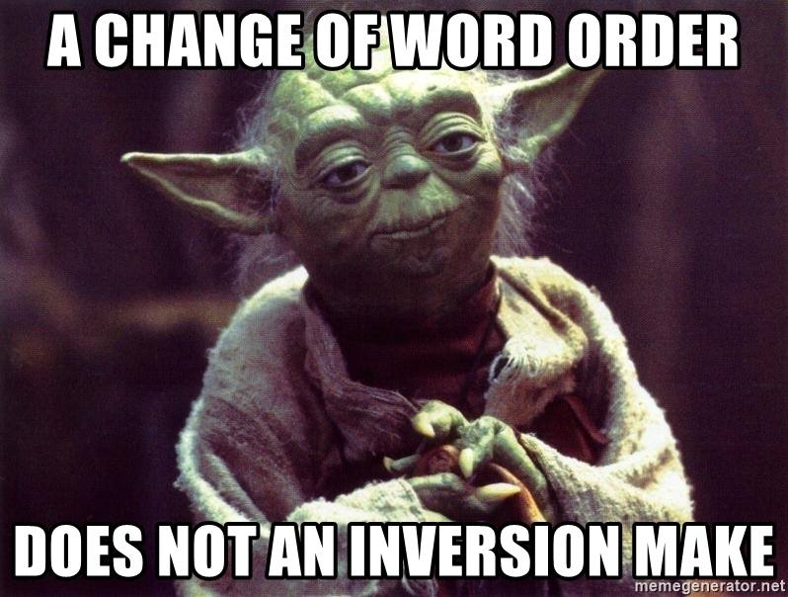
Interrogative sentences: wh- questions
Interrogative pronoun (who, what, where, why, when, how)
Verb
Adverbs
place, time, manner etc.
Object
Therefore, questions about subjects do not use the inversion (interrogative word order!
I drive my car alone to work every day. – for the subject
Who drives your car / alone to work?

Slide 8
The order of adjectives
For lunch, I had
one
awful
giant
round wooden plate of something that tasted like an
old
brown
Hungarian stew.

Slide 9
The order of adjectives

