Slide 1
English Language 3: Translating and Giving Presentations

Slide 2
Serbian English
„English in Transport and Traffic Engineering“, page 13, ex. VIII
Take some time to read the sentence over and translate it,
keeping in mind the following:
do we keep this as one extra-long sentence?
what is the best location for time constructions?
how do we translate this as professionally as possible?

Slide 3
Serbian English
„U Ujedinjenom Kraljevstvu mnogo se godinama ulaže u prevozni sistem...“
For years, the United Kingdom...
For years = duration -> present perfect
Transport system Transportation system

Slide 4
„sa izgledima“
New sentence – In all likelihood, 16... will go
One sentence – with the intention of 16... going into...

Slide 5
„milijarda“ ->
„novac dobijen od poreza“ ->
„ode“
„Britanska železnica“ ->
milliard vs. trillion (British used to count like us)
taxpayer money (funds)
will go into/going into, be spent on/spending on
British Rail National Rail

Slide 6
BrE: the underground, the tube;
AmE: the subway, the metro.
Light Rail Transit (LRT) ≠ tram ≠ subway
Untangling multi-word units:
„sistem upravljanja vazdušnim saobraćajem“
air traffic
management
system

Slide 7
English Serbian
„Testovi, zadaci, i teme iz engleskog jezika“
page 172, prevod sa srpskog
Take several minutes to translate this text into Serbian, taking into consideration how to make it sound natural and professional.

Slide 8
English Serbian
House vs. Home
Translating the verb to be
Broadcast television
Computer

Slide 9
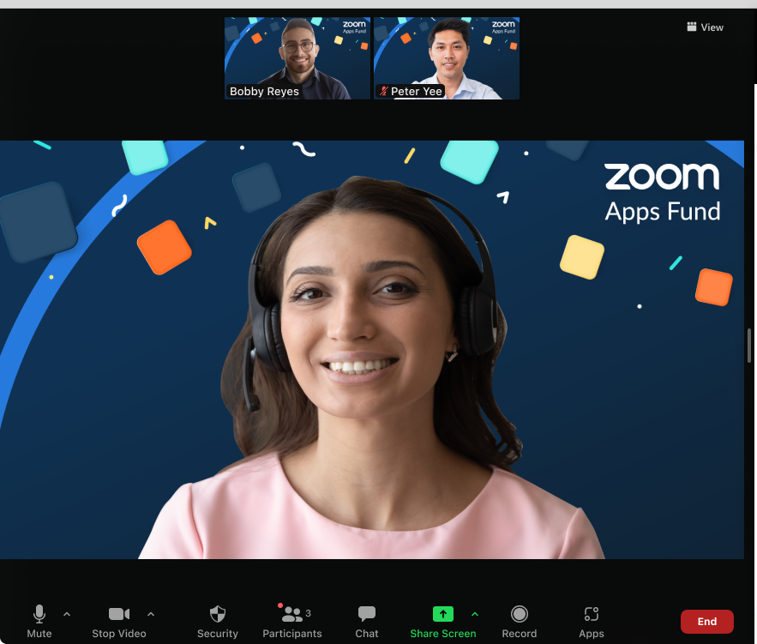
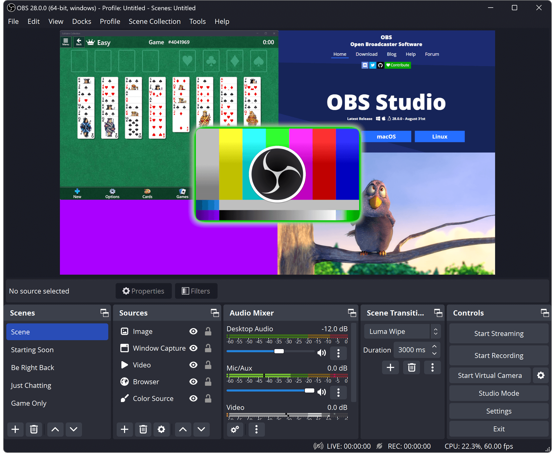
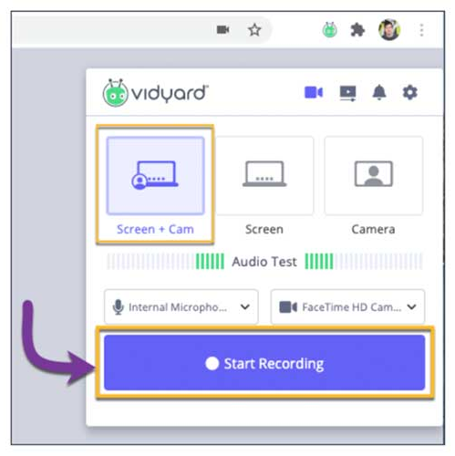
Giving Presentations
How to record your screen:
1) Zoom
2) OBS Studio
3) Vidyard Chrome extension

Slide 10
The Classic Presentation Structure
1)
Introduction
Outline
2)
Main points (divisible into parts)
3)
Summary
Conclusion

Slide 11
Introduction and Outline
Greeting your audience
Address the audience, state your name and position
What you’re talking about - Title and subject of your presentation
Briefly define the topic you’re discussing and state the title visible on screen
Purpose (optional)
Why are you there to present?
Outline
What is the structure of your presentation like?

Slide 12
Main Body – Linking Words
Sequencing and introducing topics: Firstly, First and foremost, First of all, following, subsequently, next, last but not least...
Contrasting: although, despite, in spite of, however, nevertheless, contrastingly, conversely, on the contrary, on the other hand, apart from this, in contrast to, whereas...
Presenting evidence: bars, graphs, charts (make sure you explain them in the talk)
Illustration: for example/instance, such as, in other words, as revealed by, in this case, illustrated by...
Reinforcing a point: additionally, in addition to this, also, not only...but, likewise, furthermore, moreover...
Emphasising your point: undoubtedly, unquestionably, especially, indeed...
Presenting cause and effect: because, since, for, therefore, thus, hence, leads to, consequentially, due to, owing to, as a result...

Slide 13
Summary and Conclusion
Summary: in short, to sum up, altogether, in summary/conclusion, to conclude/summarise
Conclusion: results, advice, empirical evidence, final thoughts.
Take a look at the mini-presentation in front of you. What do you think is good? What would you have done differently?

Slide 14
Something to remember before you record:

Slide 15
Discussion and Assignment
Are you afraid of public speaking?
What do you feel when you have stage fright? How do you overcome it?
Have you ever heard of these ways of combating stage fright: Dutch courage, deep breathing, stretching, meditation, or any other way? Have you tried any?
Have you ever held a presentation in front of people? What was the experience like?
Have you ever held a group presentation? What was the experience like?
Assignment: Choose one of the 2 texts we covered in class today and throw together a short presentation on the topic, then present it to your group. You can make “facts“ up, fabricate statistics, or invent anything to contribute to your talk.

Slide 16
Thank you for your attention!

