Slide 1
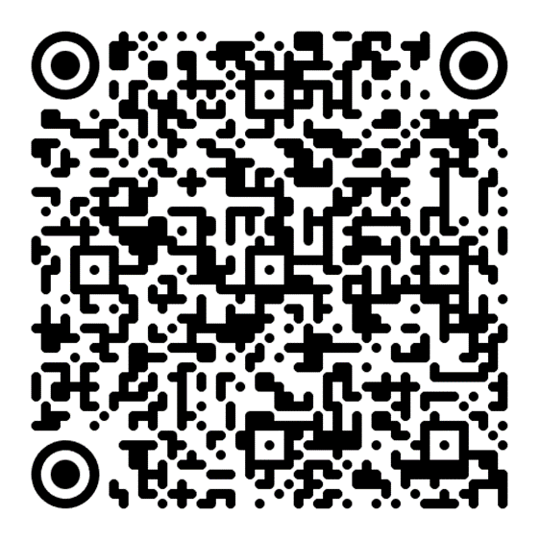
CONTINUOUS tenses

Slide 2
Present Continuous – How do we make it?
Statements
Questions
Negations
Auxiliary verb to be (present tense) + -ing form (present participle)
I am working
You are working
He/she is working
1. We are working
2. You are working
3. They are working
Just use the inversion on the pronoun and the auxiliary to be.
I am working
You are working
He/she is working
1. We are working
2. You are working
3. They are working
Just add not after to be.
I am not working
You are not working
He/she is not working
1. We are not working
2. You are not working
3. They are not working

Slide 3
Present Continuous – When do we use it?
Ongoing actions that have a duration
Temporary actions
Future actions and plans
Annoying habits
The weather is slowly becoming cold. / I’m not getting any younger.
She is working on a surprise. ≠ She works for the CIA.
In four years, I am getting a degree in Transport & Traffic Engineering
You’re always leaving your clothes in piles on the floor!

Slide 4
Past Continuous – How do we make it?
Statements
Questions
Negations
Auxiliary verb to be(past tense) + -ing form (present participle)
I was working
You were working
He/she was working
1. We were working
2. You were working
3. They were working
Just use the inversion on the pronoun and the auxiliary to be.
I was working
You were working
He/she was working
1. We were working
2. You were working
3. They were working
Just add not after to be.
I was not working
You were not working
He/she was not working
1. We were not working
2. You were not working
3. They were not working

Slide 5
Past Continuous – When do we use it?
Past actions that had a duration (also temporary)
Past action that had a duration (but interrupted)
Two past actions that had a duration (simultaneous)
Annoying habits (in the past as well!)
I was sleeping the entire weekend. / He was working as a double agent the whole time! (vs. He worked as an agent back in 1987)
She was playing video games when her phone rang.
While the teacher was talking, I was not listening to a single word.
They were always leaving their trash all over the apartment!

Slide 6
Future Continuous: a tense that is not a tense
Two ways to make it and use it:
Modal will + bare infinitive (continuous) – less probable
Semi-modal going to + bare infinitive (continuous) – more probable

Slide 7
Future Continuous: a tense that is not a tense
What is a continuous infinitive?
Regular infinitive:
Make it –ing
What is missing? Auxiliary?
to work
to working?
to be working!

Slide 8
Future Continuous – How do we make it?
Statements
Questions
Negations
Modals will/shall or semi-modal going to + progressive infinitive
I will/am going to be working
You will/are going to be working
He/she will/is going to be working
1. We will/are going to be working
2. You will/are going to be working
3. They will/are going to be working
Just use the inversion on the pronoun and the modal/ auxiliary verb to be.
I will/am going to be working
You will/are going to be working
He/she will/is going to be working
1. We will/are going to be working
2. You will/are going to be working
3. They will/are going to be working
Just add not after the modal verb/to be (if you use going to)
I will/shall/am not (going to) be working
You will/shall/are not (going to) be working
He/she will/shall/are not (going to) be working
1. We will/shall/are not (going to)be working
2. You will/shall/are not (going to) be working
3. They will/shall/are not (going to) be working

Slide 9
Practical exercises
English grammar: page 24 – ex. I, sentence: 27
Testovi: page 4 – sentence 4
page 5 – sentence 2
page 6 – sentence 1
page 7 – sentence 1
page 8 – sentence 5 (translation), 2
page 11 – sentence 4 (translation)
page 12 – exercise V, sentence 5
page 13 – ex. VI sentence 5, ex. IX sentence 5
page 14, sentence 3 (translation)
page 17, exercise IX, sentence 3
page 21, exercise IX, sentence 2, 5
page 24, ex. V, sentence 2
page 28, sentence 2 (translation)
page 30, ex. VI, sentence 4
page 31, sentence 2
page 36, sentence 3 (translation)
page 45, sentence 2
page 56, ex. VI, sentence 1
page 72, ex. V, sentence 3

Slide 10
Thank you for your attention!

