Slide 1
Welcome to English 1!

Slide 2
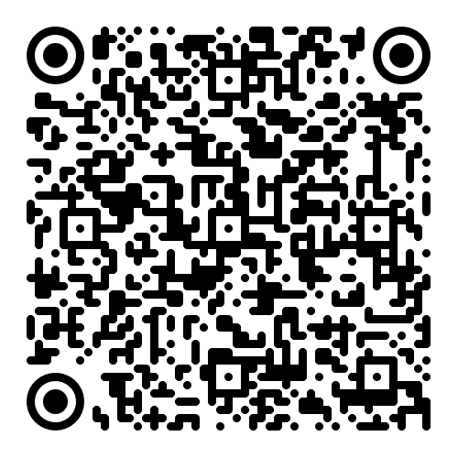
Introduction
E-mail: s.stefanovic@sf.bg.ac.rs
Consultation hours: Thursdays 11h-12h (room 05)
(announcing your attendance at least one day in advance is mandatory)
Please sign up in the list, and let me know if you decide not to attend!

Slide 3
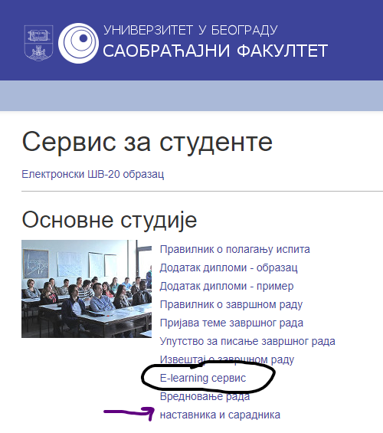


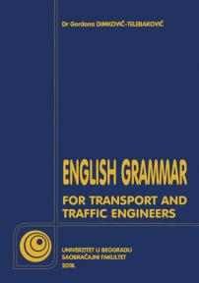
In case you do opt for English 1...
Moodle: nastava.sf.bg.ac.rs
Student books:
Do not forget to sign up for the subject electronically!
Do not forget to apply for the exam electronically!

Slide 4



Exam structure
Written Exam: 80 points + Oral Exam (optional): 20 points
Colloquium 1 (40 points) – held in November during class (optional) + during regular exam terms
Written Exam Colloquium 2 (40 points) – held during a pre-term, and during regular exam terms
Oral Exam in-class activity (10 points)
oral exam (10 points) – choose one of the text we’ve covered in class, and talk about it; duration: ~3 minutes)
Students always need at least half of total points +1 to pass;
Minimum to pass each colloquium: 21 points.
Minimum to pass the subject: 51 points.
In case someone passes both colloquiums barely, obtaining 42 points, they will have to take the oral exam to make up for the difference.

Slide 5

Written Exam = Colloq. 1 + Colloq. 2
Colloquium 1:
  Tenses
  Passives
  Modals
Colloquium 2:
  Articles
  Non-finite Verb Forms
  Vocabulary
Note that you may choose to take either colloquium in whichever exam term you want,
or both at the same time!

Slide 6
Oral Exam
Choose one text from the book “Testovi, zadaci, teme“ – you can pick any text, but it’s advisable to opt for one that we have covered in class (easier, known vocabulary). Talk about it for 3 minutes,
re-tell it, state your opinion on it, add fun facts – whatever you want! But, make sure you display your familiarity with transport and traffic vocabulary and a range of grammar structures.
Full list of texts: pages 3-11, and the text on page 15
When can you take the oral exam?
  After/before class
  During the break between classes
  During consultation hours (announce your attendance via email!)
  During the exam terms - right after the written test

Slide 7



Class & Exam Structure & Goals
ALL TEXTS that we will cover (materials for exam): pages 3-11 + page 15
Class structure: Grammar, exercises, vocabulary, discussion (1 break)
Extreme importance of applying for the exam AND having your final mark signed into your booklets!
The aim of English courses (ESP):
To familiarise students with the terminology for Transport and Traffic Engineering
To facilitate a fluent, accurate usage of the foreign language
To enable students to use the language more freely in everyday communication
To understand and be understood by native speakers

Slide 8
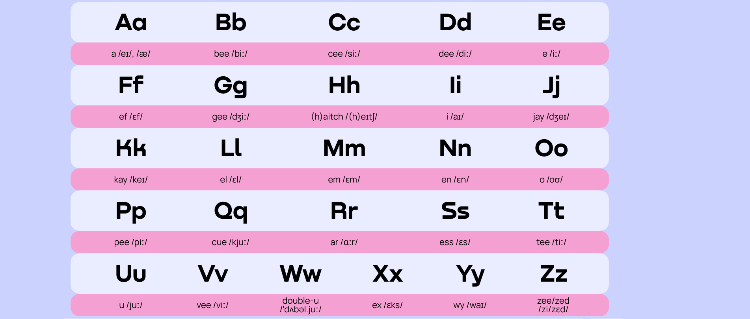
The English Alphabet

Slide 9
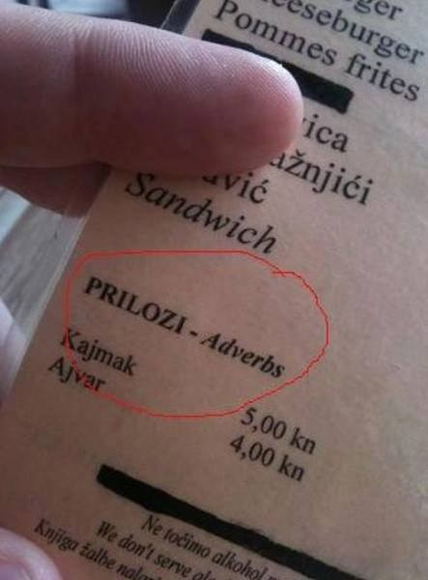
Vrste reči = Parts of Speech
Nouns
table, book, car, Ana, Earth, confusion, anger, fear, student...
Imenice
Zamenice
Glagoli
Brojevi
Pridevi
Prilozi
Predlozi
Veznici
Članovi
Pronouns
I, you, me, mine, yours, himself, everyone, anybody
Verbs
to love, worked, talking, had done
Numbers
thirteen, first
Adjectives
sociable, introverted, fun
Adverbs
slowly, kindly, beautifully
Prepositions
in, into, at, out, above, below
Conjunctions
and, despite, but
Articles
a, an, the

Slide 10

Context is everything!
I have red shoes. vs. I love red.
Activity for next time:
Learn how to spell your full name!

Slide 11
Traffic vs. Transport
Traffic refers to the movement of vehicles, goods, or people (pedestrians) in an area that uses infrastructure as a means of travelling from place to place. It could refer to cars moving along roads and highways, aircrafts flying in and out of airports, ships moving along charted routes, and so on.
Transportation (transport) is the system or means by which creatures or objects are moved from one place to another using modes such as road vehicles, trains, aircraft, ships, and so on.

Slide 12

Thank you for your attention.

