Slide 1
Non-Finite Verb Forms:
Infinitives

Slide 2


Non-finite VF
Non-finite Verb Forms:
    Infinitives
    Gerunds
    Participles
(to work, to have worked, to be working...)
(skiing (is fun), studying (is difficult), shopping (is boring)
Present participle
Past participle
Perfect participle

Slide 3
Infinitives: the main 2 types
Bare infinitive – after modals
will
Full infinitive (a.k.a. To-infinitive)
work / be working / have worked / have been working, etc.
to work / to be working / to have worked / to have been working, etc.

Slide 4
Infinitives: its “tenses“
 | Simple | Perfect | Continuous | Perfect Contin.
Active
Passive
to have done
to be doing
to have been doing
to do
to be done
to have been done
Engineers will have been removing the traffic lights from the roundabout and then re-installing them back and forth for about 2 months next week.
Engineers will have removed the traffic lights from the roundabout by next Monday.
Engineers will remove the traffic lights from the roundabout next week.
The traffic lights will have been removed from the roundabout next time you pass.
Engineers will be removing the traffic lights from the roundabout when you arrive.
The traffic lights will be removed from the roundabout next week.

Slide 5
Fast Handling System
October 1994, page 10

Slide 6
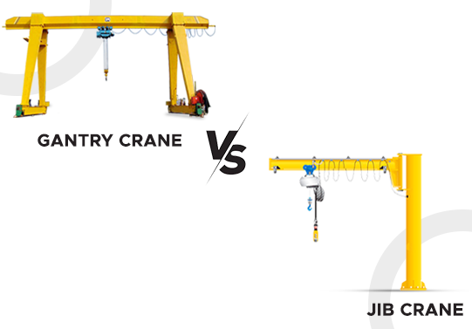
Fast Handling System
(overhead) gantry crane
loading & discharge/unloading
high rack storage system
store handing devices
aisles
capacity requirements
Sistem za brzo rukovanje robom
(nadglavna/portalna) mostna dizalica
utovar i istovar
visokoregalni skladišni sistem
manipulativna oprema
(radni) prolazi
zahtev za kapacitetom

Slide 7
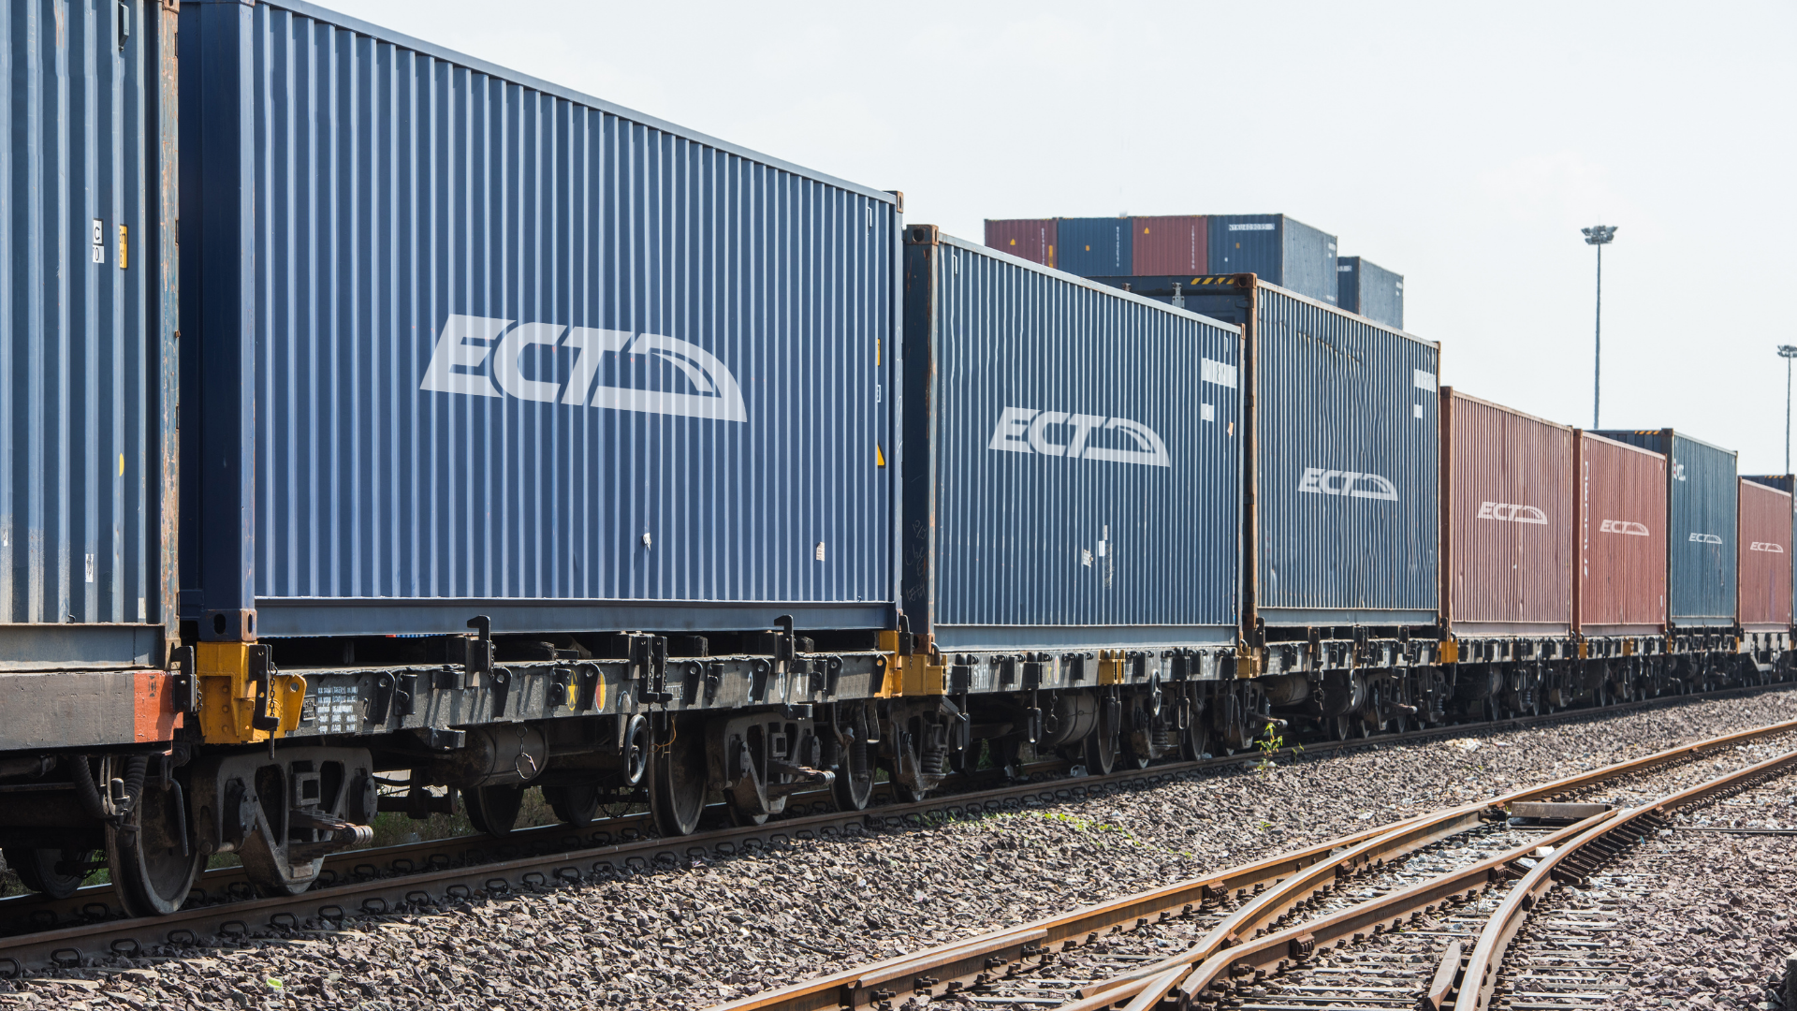
control engineering and data processing systems
block trains
handle
units for offloading
jibs
swapbodies
intermediate storage
truck loading
sistemi kontrolnog inženjerstva i obrade podataka
blok vozovi
pretovar
jedinice za istovar
šipke
kontejneri, tovarni sanduci
međuskladištenje
utovar kamiona

