Slide 1
PREPOSITIONS
PAVEMENTS, AND PLASTICITY, oh my!

Slide 2
TABLE OF CONTENTS
01
02
03
PREPOSITIONS
PAVEMENT THICKNESS DESIGN
EXERCISES AND DISCUSSION

Slide 3
01
PREPOSITIONS

Slide 4
RELATIONSHIPS
RELATIVE CLAUSES -> -ING
MULTI-WORD UNITS -> COMPOUNDS
SYNTHETIC
the altitude at which the plane is cruising -> cruising altitude
speed of flying, engineer for traffic -> flying speed, traffic engineer
ANALYTIC
NO CASES -> PREPOSITIONS
via, above, below, in, out, for, from, on, through, by, to, over, etc.

Slide 5
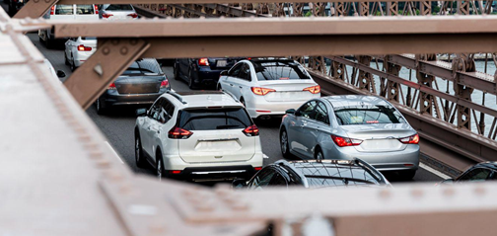
FUN FACT
Even prepositions can be compounds!
The speeding car climbed onto the sidewalk, injuring several pedestrians, and causing a huge traffic jam.

Slide 6
PREPOSITIONS
PLACE
TIME
above, behind, under, in, down, around,
in the middle of
after, by, during, for, since, at
PURPOSE
LINKING WORDS
for, to
in order to, so as to, in the end, at the beginning

Slide 7
ADVERBS vs. PREPOSITIONS
CONTEXT-DEPENDENT: same words can be both adverbs and prepositions (prepositions connect 2 concepts, indicating a relationship)
Leave the book on the table. ≠ Put your jacket on.
The book is in my bag. ≠ Look what the cat dragged in.
Go over the bridge, and take a left. ≠ Sarah was hurt, but at least it’s over.

Slide 8
PICKING PREPOSITIONS PROFICIENTLY
Sometimes same words go with different prepositions, and have a slightly different use.
ENROLL
TIME
THE BEGINNING
You enrolled at the Faculty of Transport and Traffic Engineering in 2023.
≠
I enrolled in this course just this semester.
In time, Sarah will realise she is better off without her ex.
≠
He can never get anywhere on time.
At the beginning of this presentation, there was the title slide.
≠
In the beginning, she didn’t feel any pain, but she later found out she had broken her arm.

Slide 9
PRACTICAL EXERCISES: GRAMMAR
PAGE 63
PAGE 64
EXERCISE XXXIV
(skip 17, 19, 20)
EXERCISE XXXV

Slide 10
02
PAVEMENT THICKNESS DESIGN
English in Transport and Traffic Engineering, page 63

Slide 11
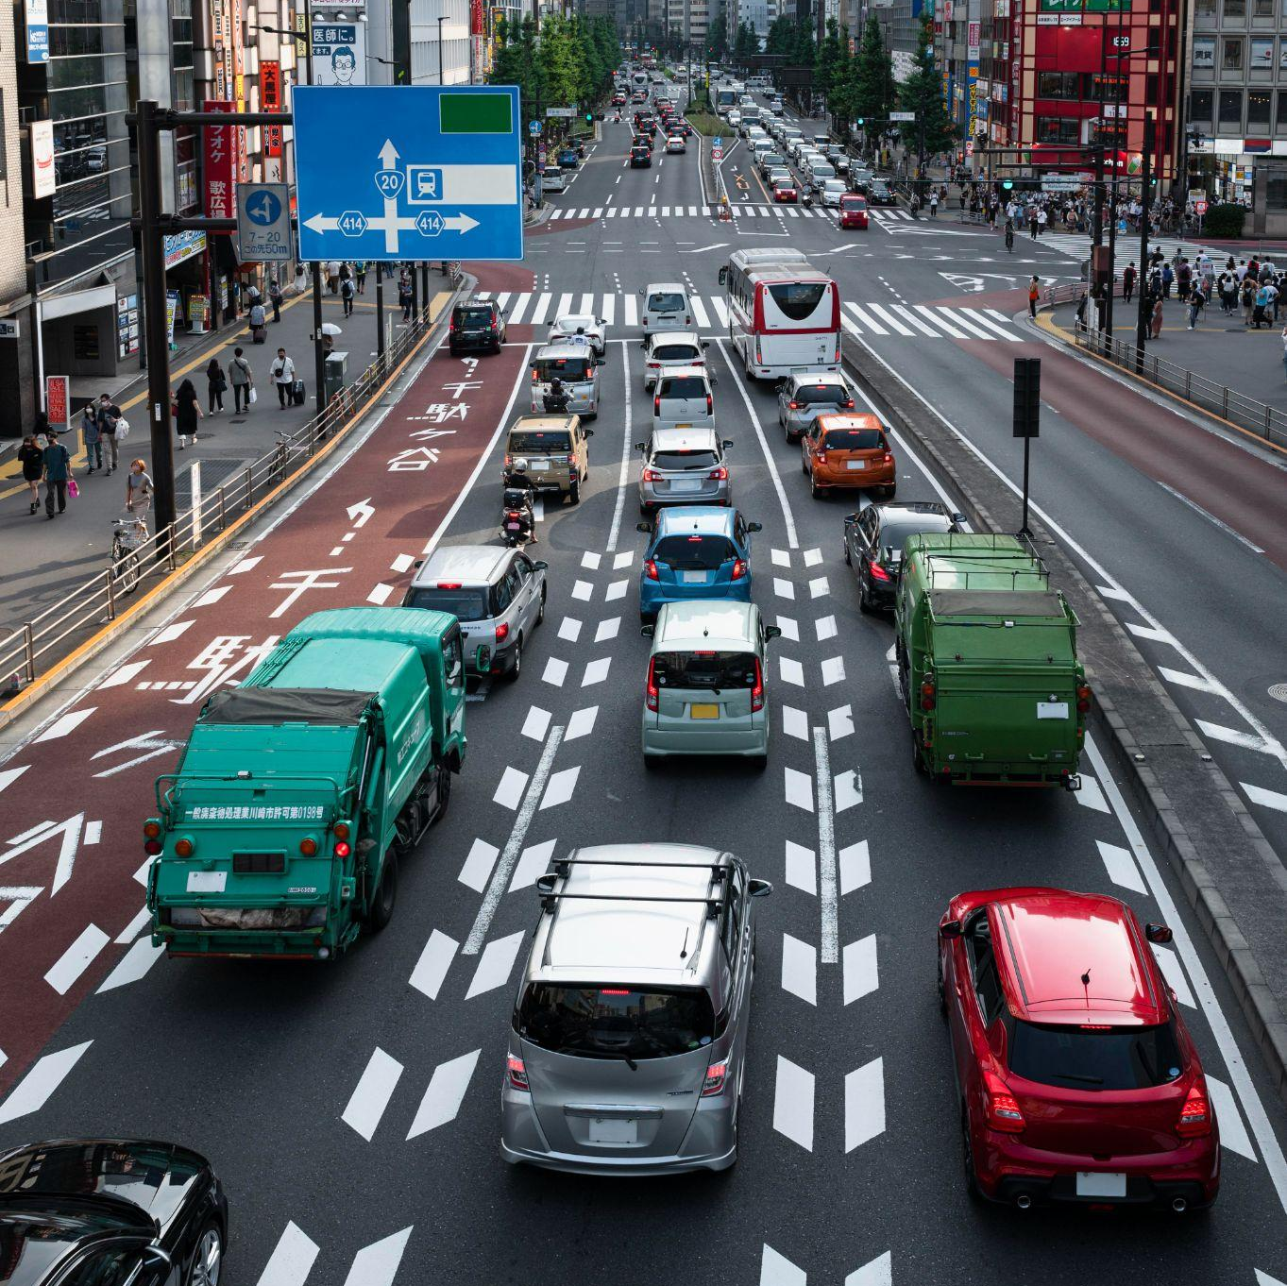
PAVEMENT:
Hard surface of a road / street
Side of the road where pedestrians walk
Kolovozni zastor
AmE: sidewalk; trotoar, pločnik

Slide 12
Road components:
Lane
Median strip, central reservation, roadway median, traffic median
Shoulder
A section of the road where cars can form a row (picture – cars in 3 lanes)
Dual carriageway/roadway can be in 2 directions or 1
(razdelno) ostrvo (like in the picture)
Lane next to the main lanes that is used for emergencies (zaustavna traka)

Slide 13
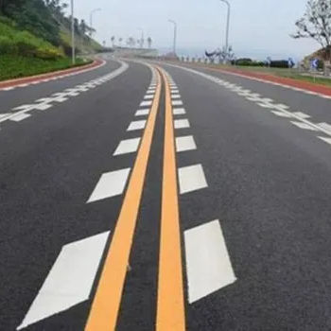
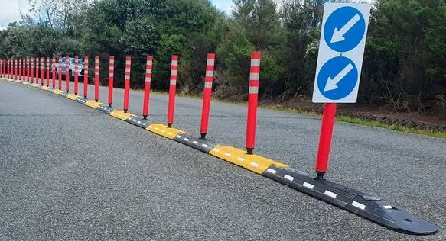
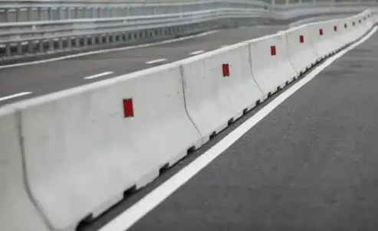
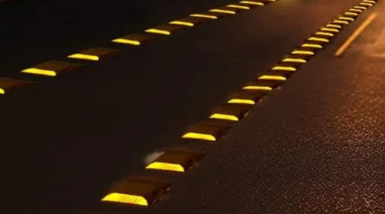
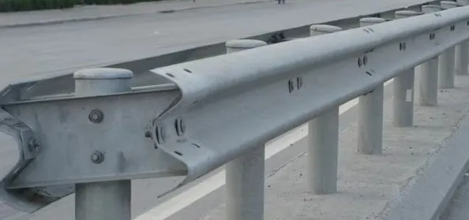
Road components:
Lane divider ≠ Median divider
Road divider (paint) lines vs. Physical barriers:
bollards (flexible)
metal, concrete (fixed)
Light
3. Broken line ≠ (double) solid line ≠ dotted line
Separates 2 lanes going in the same direction (white)
Separates 2 lanes going in opposite directions (yellow)
Note: depending on the colour of the lines, motorists know not only if they are allowed to overtake, but if they can change lanes as well
isprekidana
(dupla) puna
sitno isprekidana (indicates a merge, or change in the type of line)

Slide 14
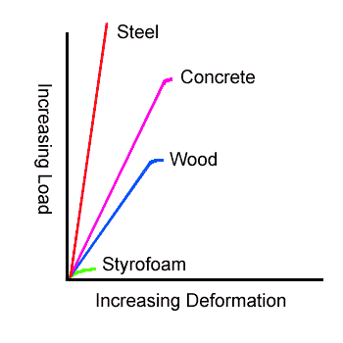
REVIEWING CONCEPTS
APPLIED WHEEL LOADS
ELASTIC AND PLASTIC DEFORMATION
dejstvo osovinskog opterećenja
elastična i plastična deformacija
FATIGUE (LOADING)
VOLUMETRIC CHANGES
STRESS (IMPOSED ON THE SUBSOIL)
zamor materijala
(usled/pod opterećenjem)
pritisak (nanet na donji sloj tla)
promene zapremine

Slide 15
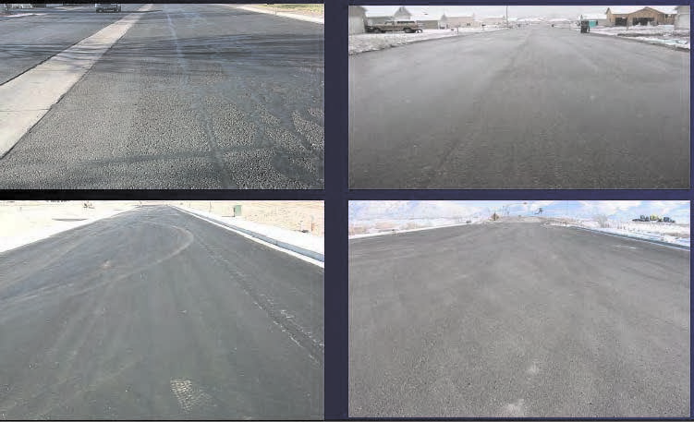
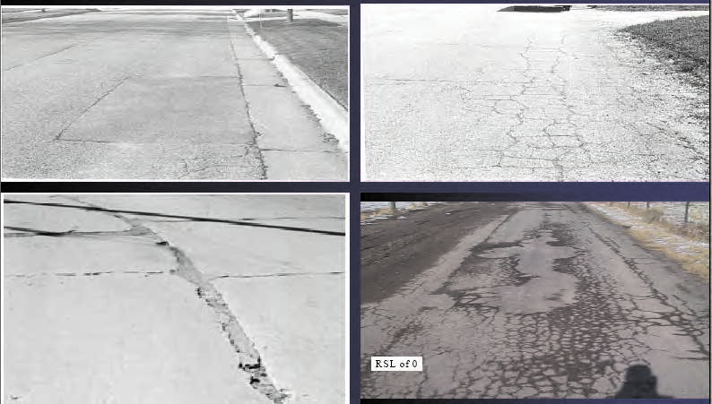
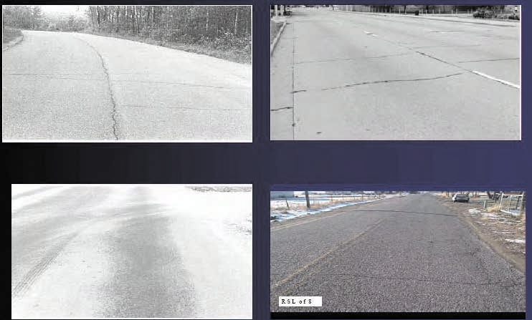
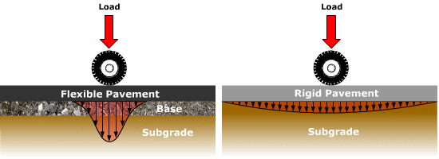
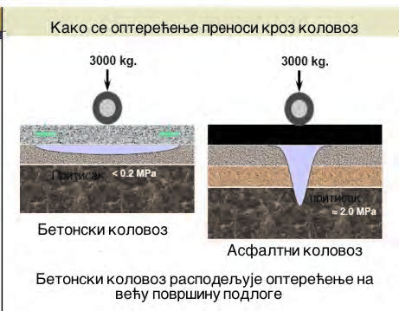
REVIEWING CONCEPTS
Types of maintenance: preventative, corrective, urgent
HIGHWAY MAINTENANCE WORK
(RECONSTRUCTION)
održavanje auto-puteva
(opravka, popravka)
FLEXIBLE PAVEMENTS vs. RIGID PAVEMENTS
STRAIGHT EDGE
fleksibilne kolovozne konstrukcije
≠
krute kolovozne konstrukcije
lenjir

Slide 16

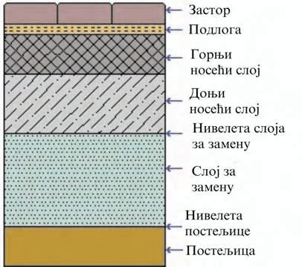
REVIEWING CONCEPTS
NEARSIDE WHEEL TRACKS
tragovi točkova
sa putničke / suvozačke strane
ROLLED ASPHALT
WEARING COURSES
asfaltni trakasti proizvodi
habajući sloj

Slide 17
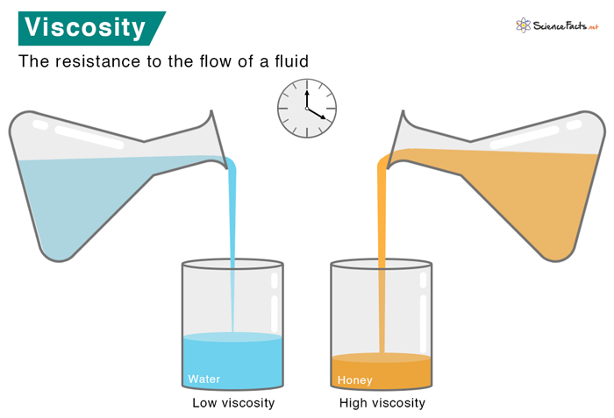
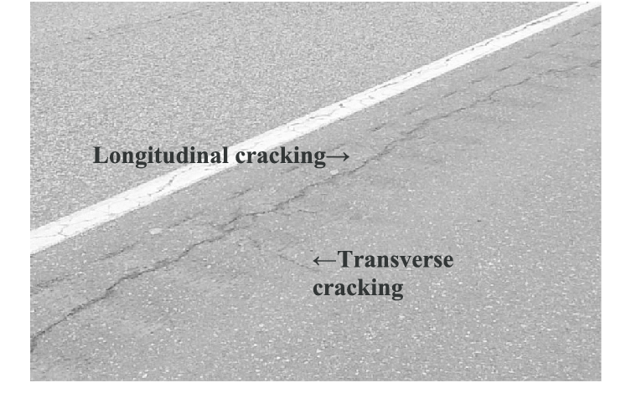
REVIEWING CONCEPTS
VISCOSITY (VISCOUS)
viskoznost
OVERLAYS
SLAB
TRANSVERSE vs.
LONGITUDINAL
sloj za ojačanje kolovoza
transverzalne pukotine
betonska ploča

Slide 18

ADDITIONAL EXERCISES & DISCUSSION
03

Slide 19
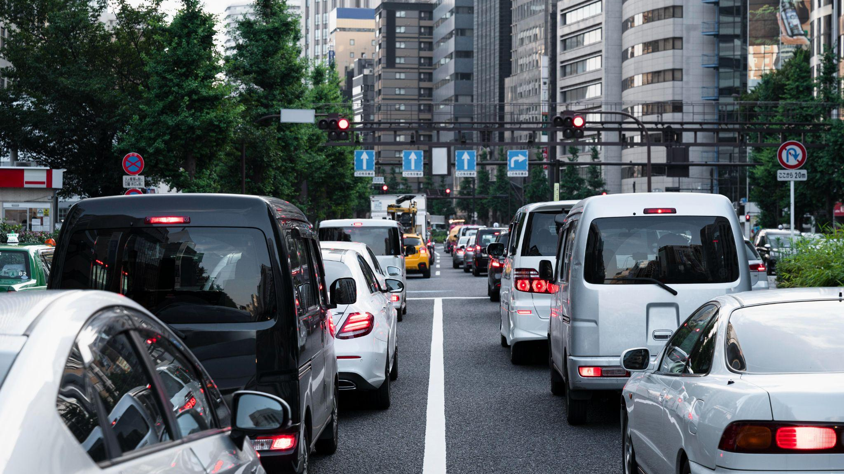
THANK YOU FOR YOUR ATTENTION

