Slide 1
Ship Parts and
Adverbs

Slide 2
Lesson Plan
01
02
Grammar: Adverbs
Grammar exercises
03
04
Vocabulary: Ship Parts
Vocabulary exercises and Discussion

Slide 3

Adverbs

Slide 4
What do they modify?
Verbs
Nouns
That car can go quickly.
The above sentences are all about fast cars.
Adjectives
Phrases
It is a very fast car.
The car is almost halfway across the bridge.
Adverbs
Sentences
She drives too fast.
Fortunately, she drives well.

Slide 5
What do they signify?
Manner
Quantity
Time
Degree
Frequency
Probability
Place
Though she drives quickly, she drives well.
If he had a car, he would drive everywhere.
After much planning, the party was very fun.
Affirmation
You have to wake up early tomorrow.
She drives too quickly.
She will surely end up in jail if she keeps driving like that.
Negation
He would go out more frequently if he had a car.
Perhaps we can go on a cruise?
We will never go on a cruise.

Slide 6
Adjectives vs. Adverbs
With linking verbs, we use adj, not adv! (be, see, feel, smell...)
BAD
Can I please leave the lecture, I feel really
Because of the burn on her hand, her sense of touch isn’t so good, and she feels
BADLY
Ever since he got a cold, he has smelled
One particular charm of public transport is that during winter most people smell
BADLY
BAD

Slide 7
Adjectives vs. Adverbs
Fast
Hard
Sometimes the adjective and the equivalent adverb are the same (no –ly)
Lamborghini Diablo is a fast car.
The car goes very fast.
This is a hard question.
I am working hard.
NOT: I am hardly working!

Slide 8

Sometimes the adverb = adjective, and either can be used.
The moon is shining bright / brightly.
She is sleeping sound / soundly.
Sometimes the adverb and adjective have completely different meanings.
Late(ly)
They were late to work because of the traffic. / Sarah has been sad lately.
High(ly)
The airplane is high in the air. / He is highly appreciated at work.

Slide 9

Grammar exercises:
Grammar book, page 61
exercise XXXIII

Slide 10
Re-write these sentences using the word in brackets. See the example.
A lot of companies are likely to go out of business. (probably)
A lot of companies will probably go out of business.
1 Windows is unlikely to remain the dominant force in software. (probably)
________________________________________________
2 People could stop using cash by around 2015. (maybe)
________________________________________________
3 The mouse is bound to disappear in the next few years. (definitely)
________________________________________________
4 There's a very good chance that mobile phones will be replaced with something different. (possibly)
________________________________________________
5 There is no chance that the rate of change will slow down. (definitely)
________________________________________________

Slide 11
Write sentences about transport&traffic using the adverbs below.
nervously
→ ___________________________________________
frequently
→ ___________________________________________
loudly
→ ___________________________________________
carelessly
→ ___________________________________________
patiently
→ ___________________________________________

Slide 12
03
Ship Parts and their Functions
English in Transport and Traffic Engineering, page 79

Slide 13
hull
superstructure
trup broda
nadgrađe
machinery
ancillary
mašine
pomoćno
port ≠ harbour
port=infrastructure
harbour can be natural
shell of the ship
winches
brodska oplata
vitla
vessel
plovilo

Slide 14
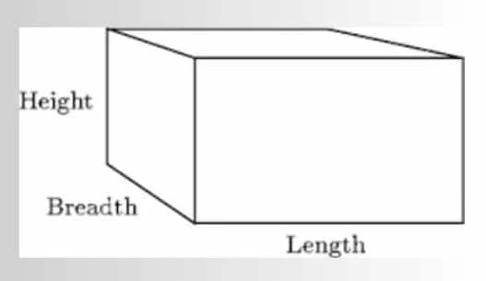
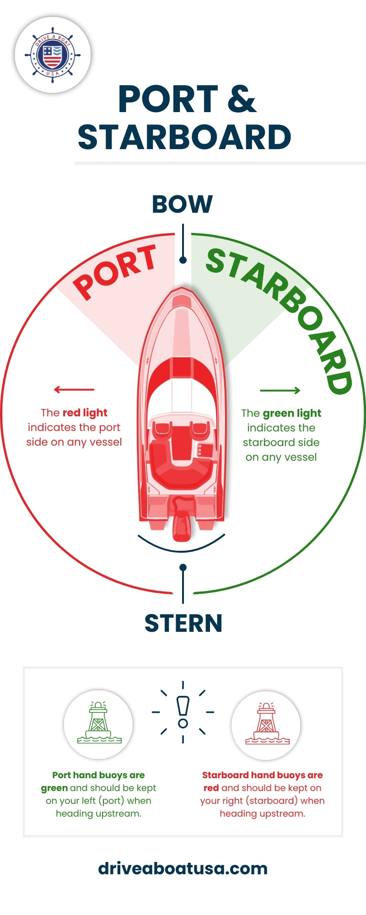
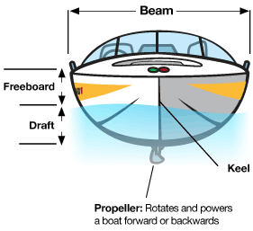
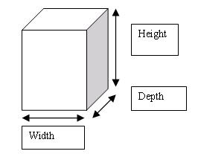
stern (aft(er) end)
amidships
krma (zadnji kraj)
sredina broda
astern
beam = width
=width
unazad
glavno rebro
bows (fore end)
keel = length
pramac (prednji kraj)
kobilica
leva i desna strana broda

Slide 15
engine room
passenger liner
mašinski prostor
Putničko linijsko plovilo
funnel
propeller shaft
dimnjak
Pogonska/propelerska osovina
shipping line
shaft tunnel
brodska kompanija
tunel p. osovine
windlass
čekrk

Slide 16
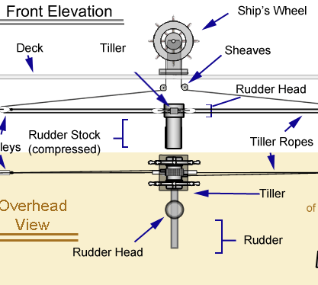
propulsion unit
heavy seas
pogonska osovina
nemirno (uzburkano) more
rudder
high seas
kormilo
otvoreno more
stabilizers
bulbous bow
stabilizatori
obli (gomoljast) pramac
rolling
pitching
valjanje/ljuljanje
propinjanje

Slide 17
turn-round time
in ballast
vreme utovara/istovara
pod opterećenjem
deck
holds
paluba
tovarni prostor
’tween decks
cargo handling
dvopalubni brod
shelter deck
rukovanje teretom
međupaluba
consignment
isporuka/pošiljka

Slide 18
Types of Ships
tugs
tramps
tegljači, remorkeri
tramper,
nelinijski teretni brod
container ships
tankers
brod kontejner, kontejnerski brod
tankeri; brod za prenos tečnih tereta
cargo liner
bulk carriers
linijski teretni brod
brodovi za prevoz rasutih tereta
barges
barže

Slide 19
lifting apparatus
quay(-side)
oprema za podizanje
kej, pristanište
derricks
bridge of a vessel
brodska dizalica
komandni most
lifting capacity
helm
kapacitet (po)dizanja
kormilarsko kolo, kolo kormila
masts
radio direction finder
jarboli
radiogoniometar

Slide 20
Let’s revise ship parts.
Quiz time!
3.5

Slide 21
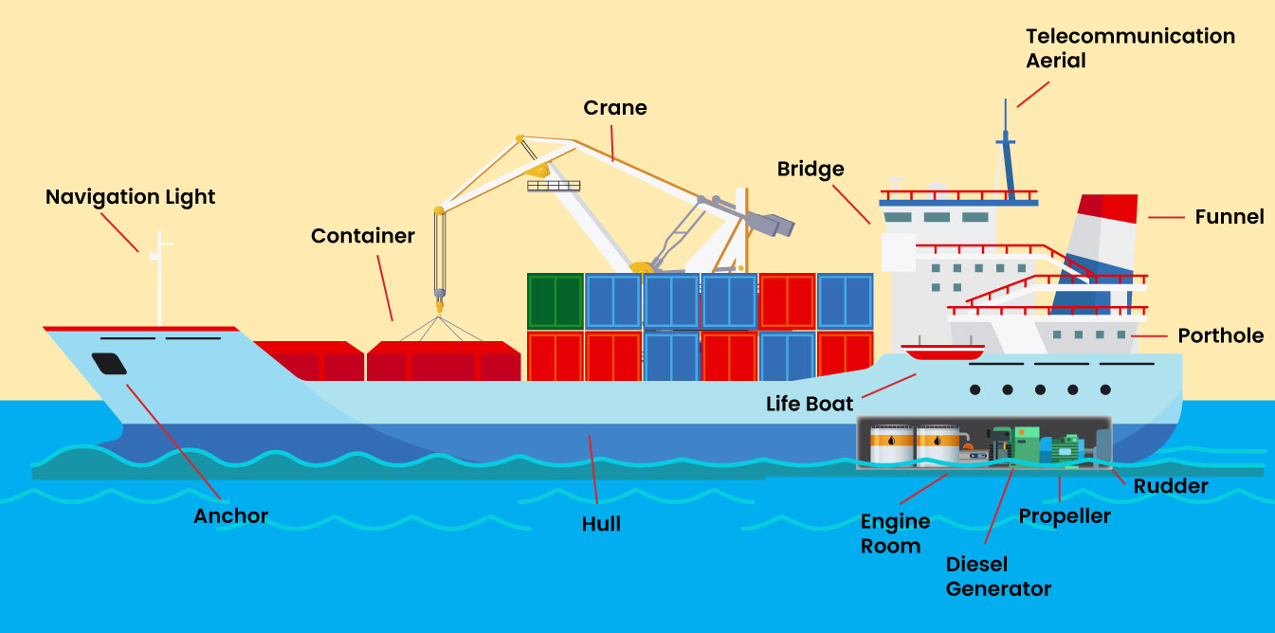

Slide 22
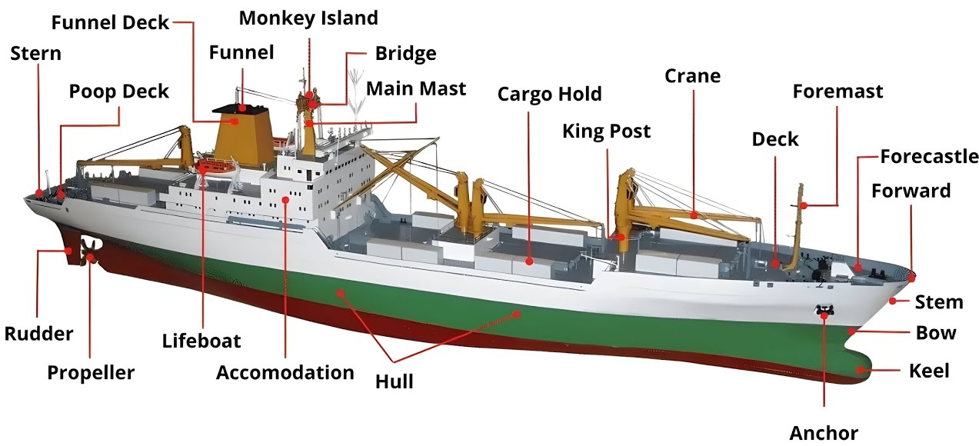

Slide 23
04
Discussion

Slide 24
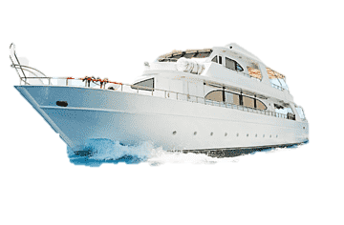
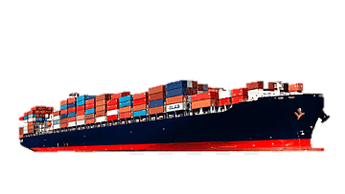
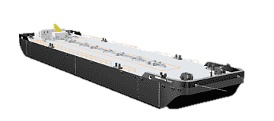
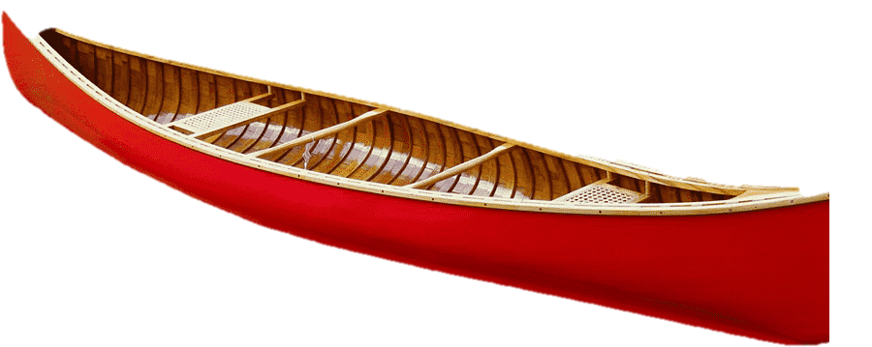
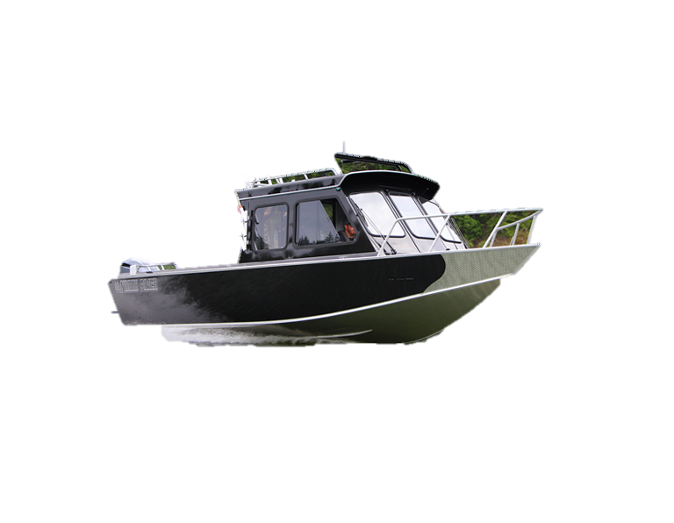
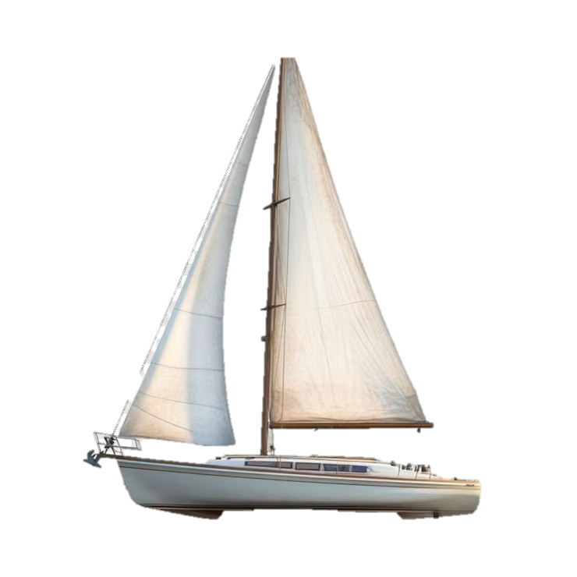
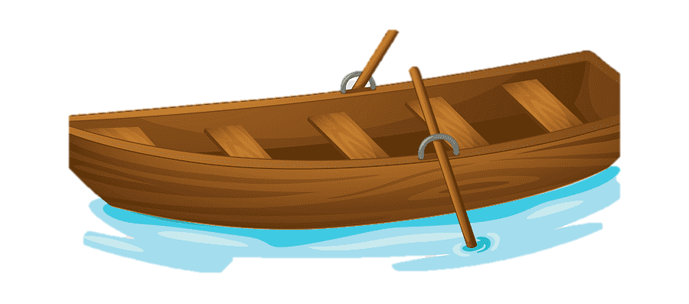
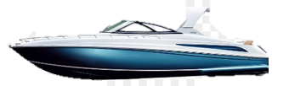
Discuss the following types of vessels: what are they? How would they be operated in different waters (e.g.heavy seas, inland water traffic, high seas, etc.) like in the example below.
Even though both a river boat and a barge are for inland water traffic, a barge carries cargo more efficiently.
yacht
cargo ship
barge
canoe
river boat
rowboat
sailboat
speedboat

Slide 25
Discuss the following:
Have you ever been on the vessels depicted in the previous slide: rowboat, yacht, sailboat, canoe, cargo liner, river boat, speedboat, barge? If yes, how was it? If not, would you like to?
Would you ever consider getting a naval license? Why/why not?
Would you ever work on a boat? Under what circumstances?
If you had to go away on a boat for 6 months, what are 3 things that you couldn’t live without while you are away?
Did you dream of being a pirate when you were little? What would have been your job on the ship?
Have you ever seen Pirates of the Caribbean? If yes, what do you think about the films? What do you like about them?
What is the metaphorical meaning of shipping: usually when you ship something, you send it, but when you say you ship someone, what does that mean?
Have you ever balanced and paddled on a surf board? If not, would you like to? If yes, what were your experiences?
Have you ever been on a kayak? If not, would you like to? If yes, what were your experiences?
What is the difference between an oar (rowing), a paddle (paddling), and punting?

