Slide 1
Numerals + Faster Interchange

Slide 2
Table of Contents
01
02
03
Grammar
Grammar Exercises
Vocabulary
Numerals and measurements
Faster Interchange

Slide 3
01
Numerals

Slide 4
Numbers
Cardinal
Ordinal
5 (five)
13 (thirteen)
42 (forty-two)
5th (the fifth)
13th (the thirteenth)
42nd (the forty-second)

Slide 5
Cardinal Numbers
Spelling: compound numbers above 20
twenty-eight, thirty-one, seventy-five, etc.
Spelling: 40
F O R T Y
u

Slide 6
100, 1k, 1M, 1B
When used as a precise, definite number – NEVER plural
Three hundred cars
Seven thousand containers
Two million vehicles
BUT: when used as imprecise numbers – can be plural
Hundreds of cars
Thousands of containers
Millions of vehicles

Slide 7
Ordinal Numbers – the Nth
st
nd
rd
1
2
3
All ordinal numbers require the definite article.
All ordinal numbers take the suffix –th, except for 1, 2, and 3!!!
*Spelling: 40th
the fortieth

Slide 8
Writing Numbers
In English – we write commas to separate thousands, millions, billions
vs.
In Serbian, we use points or blanks.
NOTE: We use the word AND after hundreds:
two hundred and thirty-five thousand
BUT ONLY after hundreds!
One million forty-five thousand two hundred AND thirty-five.
NOT
“one million and forty-five thousand and two hundred...“
English | Serbian
1,000 3,000,000 235,000 | 1.000 / 1 000 3.000.000 235.000
In English – we write points to separate DECIMALS
vs.
In Serbian, we use commas.
NOTE: in both languages, we read the decimal points/commas aloud
one point five
English | Serbian
1.5 3.14 9.8 | 1,5 3,14 9,8

Slide 9
Percentages and Fractions
Percentages are read as they are written
13% = thirteen per cent (AmE: percent)
Fractions: the numerator = cardinal number;
the denominator = ordinal number (+ -s if the numerator is >1)
⅔ - two thirds
⅛ - one eighth
⅜ - three eighths

Slide 10
Talking about dimensions
When arranging transport, we need to give details about the size and weight of the consignment to be shipped.
Size | Weight | Dimensions
X by X by X (same unit) This container is/measures /its measurements are 2 by 1.5 by 2.5 metres. | Net/Tare/Gross weight Maximum payload weighs The net/tare/gross weight of the container is...kg/tons. The container's maximum payload is ... | Long Wide High
length
width
height
Note:
American English – meters
British English - metres
Remember:
This container is almost six metres/feet long (not six metre/foot.)
BUT: It's a twenty-foot container. (not feet.)

Slide 11
Grammar Exercise:
XXXVI (page 66) write down* the numbers
02

Slide 12
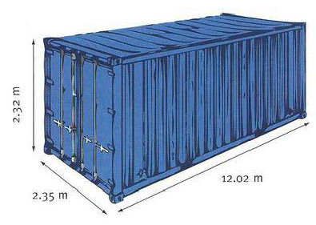
Complete the missing details and label the drawing with the words from the box.
height • payload • length • tare weight • width • gross weight
Type of container: 40 ft open top
1 ______ : 4,030 kg
2 ______ : 32,500 kg
3 maximum _______ : 28,470 kg
Internal measurements:
4 ______ : 12.02 m
5 ______: 2.35 m
6 ______ : 2.32 m

Slide 13
Rewrite the sentences like in the example below
The container is 6 metres long.
The length of the container is six metres. (Or: The container’s length is 6 metres.)
1. The package weighs 45 kg: __________________________
2. This seagoing vessel is about 30 m wide: _______________
3. The case we need to ship is 1 m long, 50 cm wide and 35 cm high: _____________________________________________
4. Its depth is nearly 3 m: _____________________________
5. The ship's length is more than 65 m: ___________________
6. The open container's door height is 7 ft 10 in: ____________

Slide 14
What do these abbreviations stand for? Which are a part of the metric system?
1) ft 10) 1"
2) kg 11) pt
3) oz 12) gal
4) fl oz 13) mm²
5) cm 14) g
6) lb
7) yd
8) cu yd
9) m²

Slide 15
03
Faster Interchange
English in Transport and Traffic Engineering, page 113

Slide 16
tare weight
tara težina
net weight / payload
neto težina / (korisna) nosivost
gross weight
(tare + net)
bruto težina

Slide 17
interchange
intermodal
throughput
pretovar
kombinovani, intermodalni
promet, propusna moć
transfer & handling process
gearing
bimodal
proces prenošenja i rukovanja
bimodalni
opremanje
unveil
harness
container/swapbody
otkriti
pripojiti, upregnuti
am
kontejner/tovarni sanduk
NOTE: swapbodies are generally longer, lighter, and not rigid.

Slide 18
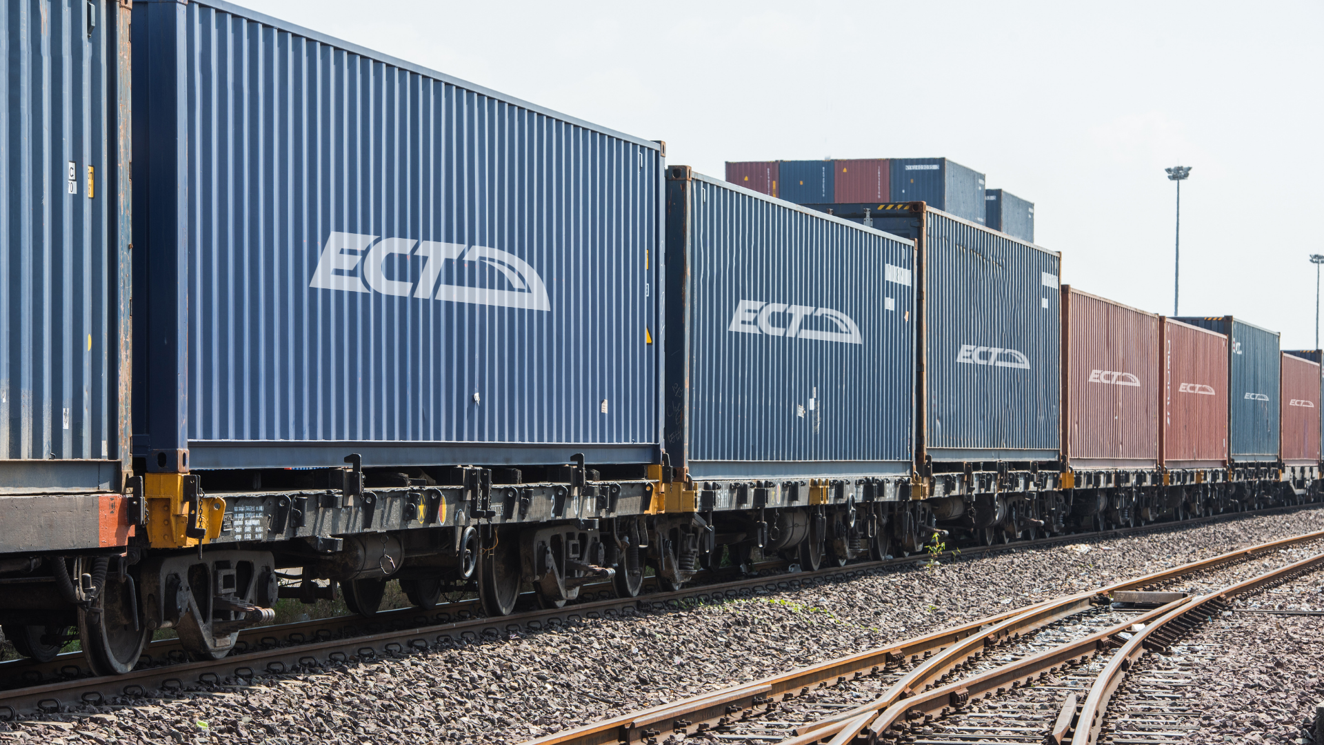
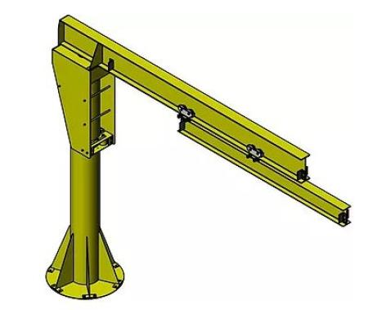
Fast Handling System
(longitudinal) conveyors
data processing system
Sistem brzog rukovanja (robom)
(uzdužne) transportne trake
sistem za obradu podataka
modular
high-rack storage system
block train
modularan, standardan
visokoregalni skladišni sistem
blok voz
design
handling devices
handling system
projektovati, osmisliti
manipulativna oprema
manipulativni sistem
(overhead) gantry crane
aisle
telescopic jibs
(nadglavna) mostna dizalica
radni prolaz
teleskopske šipke
loading/discharge
capacity requirement
intermediate storage
utovar/istovar
zahtev za kapacitetom
međuskladištenje

Slide 19
(truck) loading area
vary
fast-throughput terminals
prostor za utovar (kamiona)
biti promenljiv, varirati
visokopropusni terminali
field test/trial
facility
move on
terensko ispitivanje
objekat, ustanova
prevazići
pilot scheme
SNCF
research project
pilot-plan, pilot-shema
Société nationale des chemins de fer français
istraživački projekat
installation
know-how
experimental facility
postavljanje
znanje i iskustvo
istraživačka ustanova
under review
concerned with
put through their paces
razmatra se,
pod recenzijom
bavi se
testirati efektivnost

Slide 20
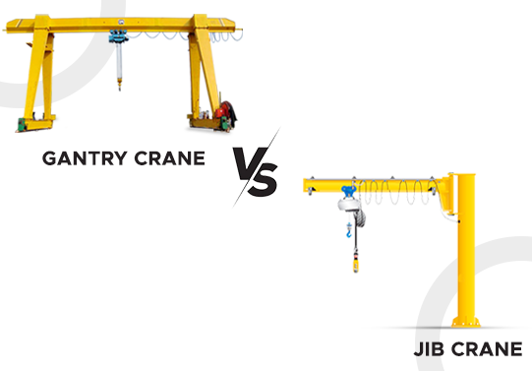
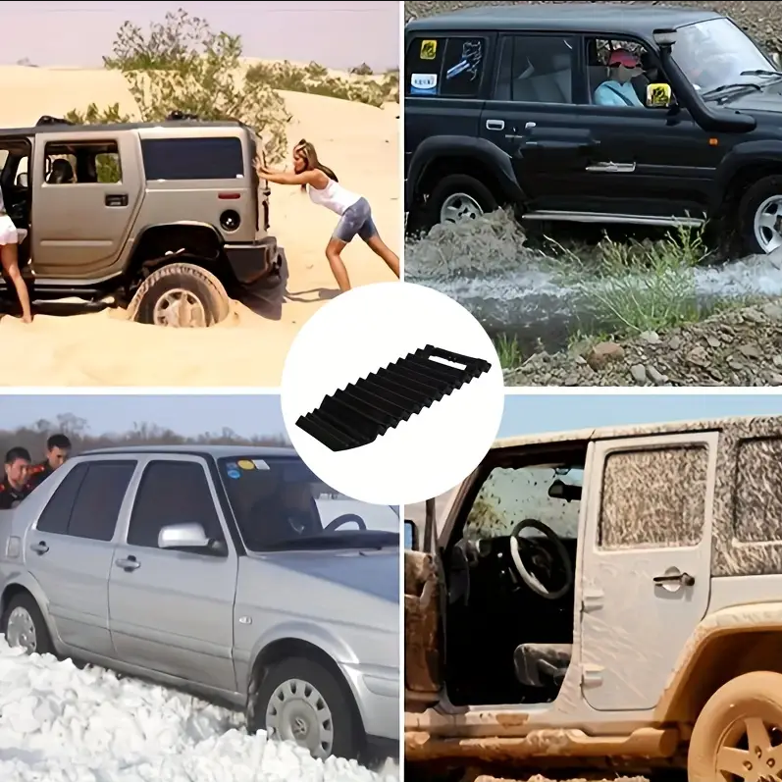
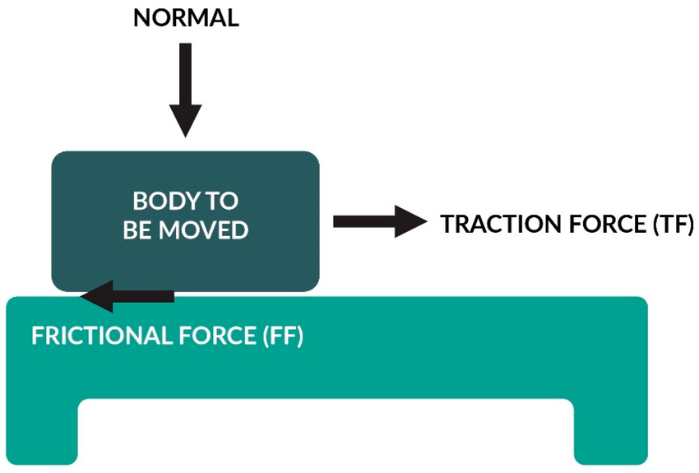
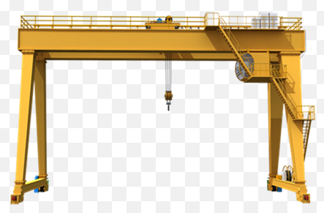
slewing device
electric traction engine
(automatic) transfer table
obrtni uređaj
vučni elektromotor
(automatski) šinski transporter
catenary
shuttle wagon
with (a) view to (commencing)
lančanica (lančani)
šatl-vagon
radi, kako bi se, u nameri, sa ciljem...
overhead cranes
semi-crane
portalne dizalice
polu-kran
Traction vs. Friction
semi-crane

Slide 21
True / False
1. | The FHS concept means the train has to stop to be loaded/unloaded. | T | F
2. | After being handled by FHS, containers need to be sent for intermediate storage. | T | F
3. | Usually, high-rack storage systems are used for intermediate storage. | T | F

Slide 22
Fill in the blanks
_________ means that a vehicle can operate on more than one means of transport.
Fast __________ imply that the _________ at the terminal is efficient.
___________ are generally lighter, softer, and larger than ___________.
If a crane stands on „two legs“, it is a ____________ crane.
___________ can refer to either a force, or an important component used in tire design.
throughputs
swapbodies
bi/multimodal
Traction
gantry
containers
interchange

Slide 23
Multiple choice
The S in FHS stands for:
What are block trains?
Semi-cranes are different from regular gantry cranes because:
a) service | b) system
c) software | d) structure
a) a cargo liner | b) passenger trains
c) single-purpose cargo train | c) trains that link ports and roads
a) They are unstable | b) they’re only half as high
c) They can carry half as much weight | d) they only have one „leg“

Slide 24
Thank you, discussion time!
How does logistics play an important role in a country's economy?
What do you know about the logistics industry in your country?
Have you ever experienced delays in postal services when sending or receiving letters? When? Why?
Which useful electronic devices in logistics and transport do you know of?
How can we deal with growing freight traffic in our country?
How do you think transport systems could be improved?
How do you think intermodal transport systems can make freight transport more efficient?
Do you think intermodal transport is applied in passenger transport? How?
If you had to choose a shipping company, what criteria would be most important for you, if you had to ship a small package? What about a fragile package? Or large amounts of cargo?
What is freight insurance? In what case would you recommend it?
What are the main logistics problems in your opinion?
Have you ever heard about payment or credit problems with customers? How do shipment agencies deal with that?
Have you ever experienced those problems at an airport?
How important is logistics for an airport?
How are company's warehouses organized?
How do you think warehousing has changed over the last few years?

