Slide 1
Possessives
&
London’s Underground

Slide 2
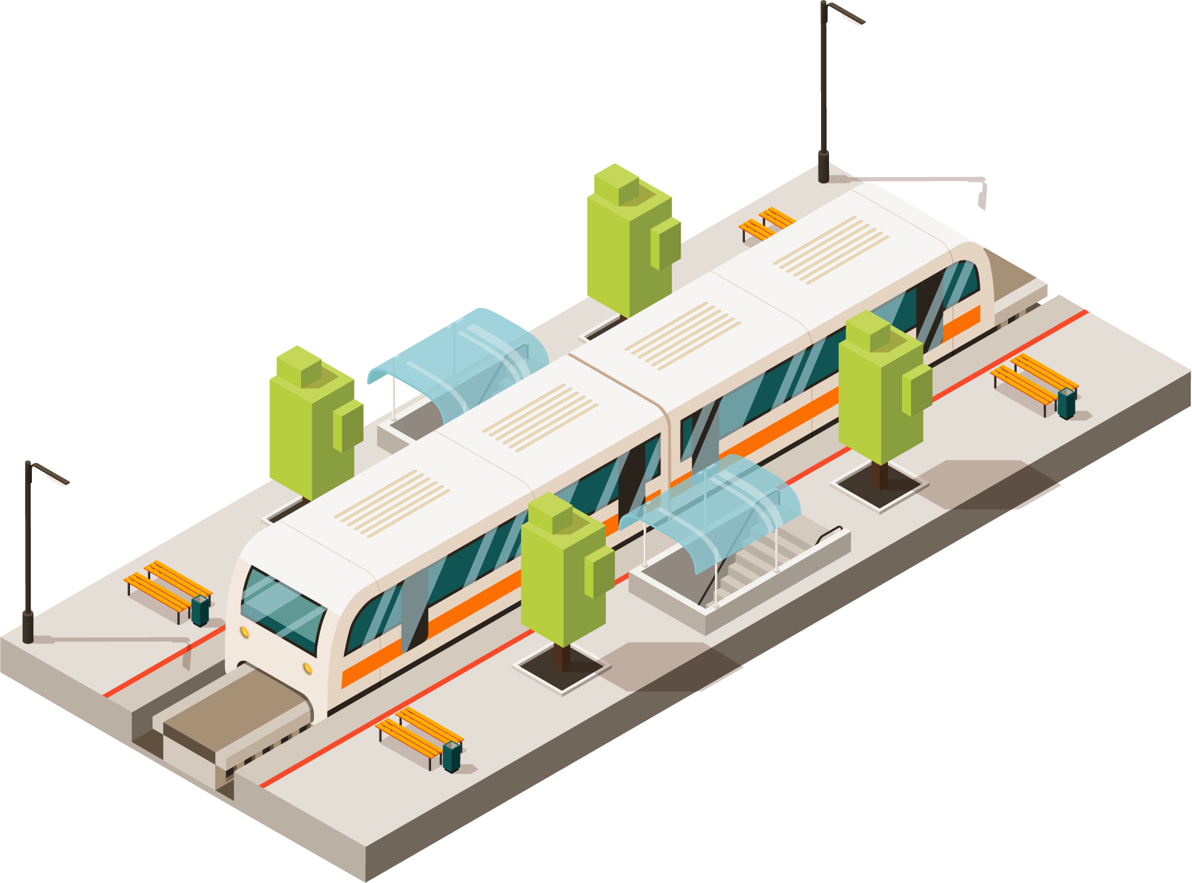
Table of contents
01
03
02
04
Grammar: Possessives
Vocabulary:
London’s Underground
Grammar exercises
Vocabulary exercises & Discussion

Slide 3
01
Possessive Case
(a.k.a. the Genitive)

Slide 4
Relationships
Synthetic: (relative clauses -> -ing / multi word units -> compounds
a.k.a. Saxon genitive)
Analytic: (a.k.a. Norman genitive)
The ocean is life’s greatest mystery.
It’s the circle of life, and it moves us all.

Slide 5
’S vs. OF-
Beings
Things
John’s bicycle
Wheels of a bicycle
Alternative:
Compound Nouns
Bicycle wheels
Note: Using both genitives is possible in colloquial speech to indicate annoyance.
ex. That ex-boyfriend of Sarah’s is awful.

Slide 6
The Saxon Genitive
’s to singular nouns:
’ to plural nouns:
Shinkansen’s average delay is 24 seconds.
Due to bankruptcy, all the trains’ staff was laid off.
Exception: men, women, children (irregular plurals)
She likes to wear men’s perfumes.
Excuse me, this is the women’s bathroom.
NOTE: even if the singular noun ends in an –s, since it’s singular we still add ’s: class’s, actress’s, physics’s...

Slide 7
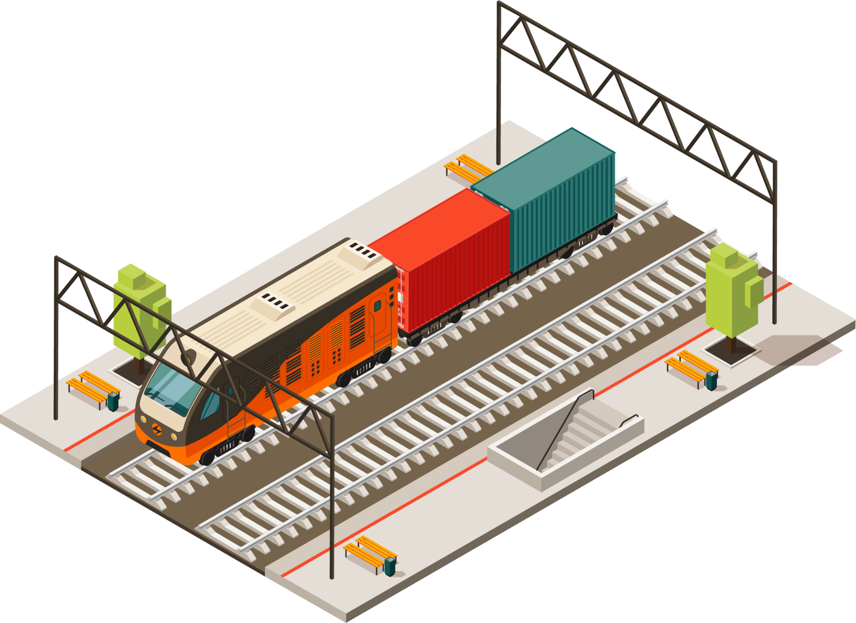
The Saxon Genitive
Sometimes complex multi-word units take the saxon genitive.
The price of these shoes is more than a month’s salary for me.
All in a day’s work!
Consider the Saxon genitive in these cases as a replacement for “worth of“.
Sometimes complex multi-word units DO NOT take the genitive, but remain as a compound.
The trip to Cologne is either a three-hour flight, or a fifteen-hour drive.
A three-ton cargo is currently being hauled.
Mostly used with people and animals, but can also go with countries, organisations, groups of people, time expressions

Slide 8
Grammar
practice
02
Grammar book, Exercise XXIV, XXV, XXVI (page 51)

Slide 9
Can the underlined words take the ´s genitive or not?
1. Jane / house - _________________
2. book / title - __________________
3. film / director - ________________
4. my brother / wife - ______________
5. boy / name -__________________
6. girls / school - _________________
7. children / parents -______________
8. problem / cause - ______________
9. page / top - ___________________
10. street / name - _______________
11. men / work - _________________
12. waitress / job - _______________
13. car / key - ___________________
14. Britain / scientists - _____________
15. NATO / alphabet - ______________

Slide 10
Compare the following phrases – all of them are correct, but do not always mean the same:
a) Jack and Jane’s children ≠ Jack’s and Jane’s children
b) a ten-minute walk ≠ ten minutes’ walk
c) Mike’s brother’s friends ≠ Mike’s brothers’ friends
d) John’s sister ≠ a sister of John’s ≠ one of John’s sisters
e) Jane’s husband ≠ that husband of Jane’s

Slide 11
03
London’s Underground
English in Transport and Traffic Engineering, page 205

Slide 12
underground (tube, subway, metro)
buoyant
podzemna železnica, metro
jak, uspešan (from buoy)
financial services provider
buoy = bova; AmE: /bui/, BrE: /boj/
buoyancy = ability of an object to float
davalac finansijskih usluga
(vast) workforce
economy
(mnogo) radne snage
privreda
≠ economics
(ekonomija)
catchment area
slivno područje
Note: aside from trains and metros, rail transport also encompasses trams, inter-terminal airport networks, and mining (and other industries’) networks.

Slide 13
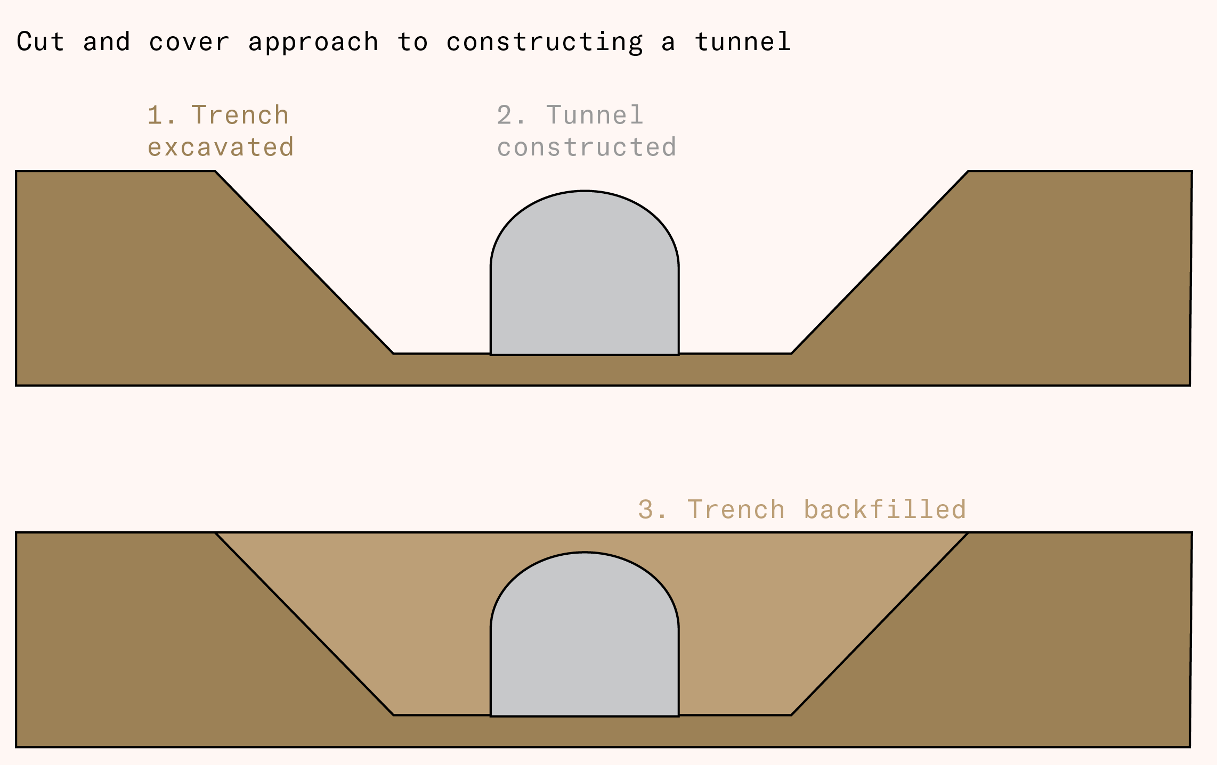
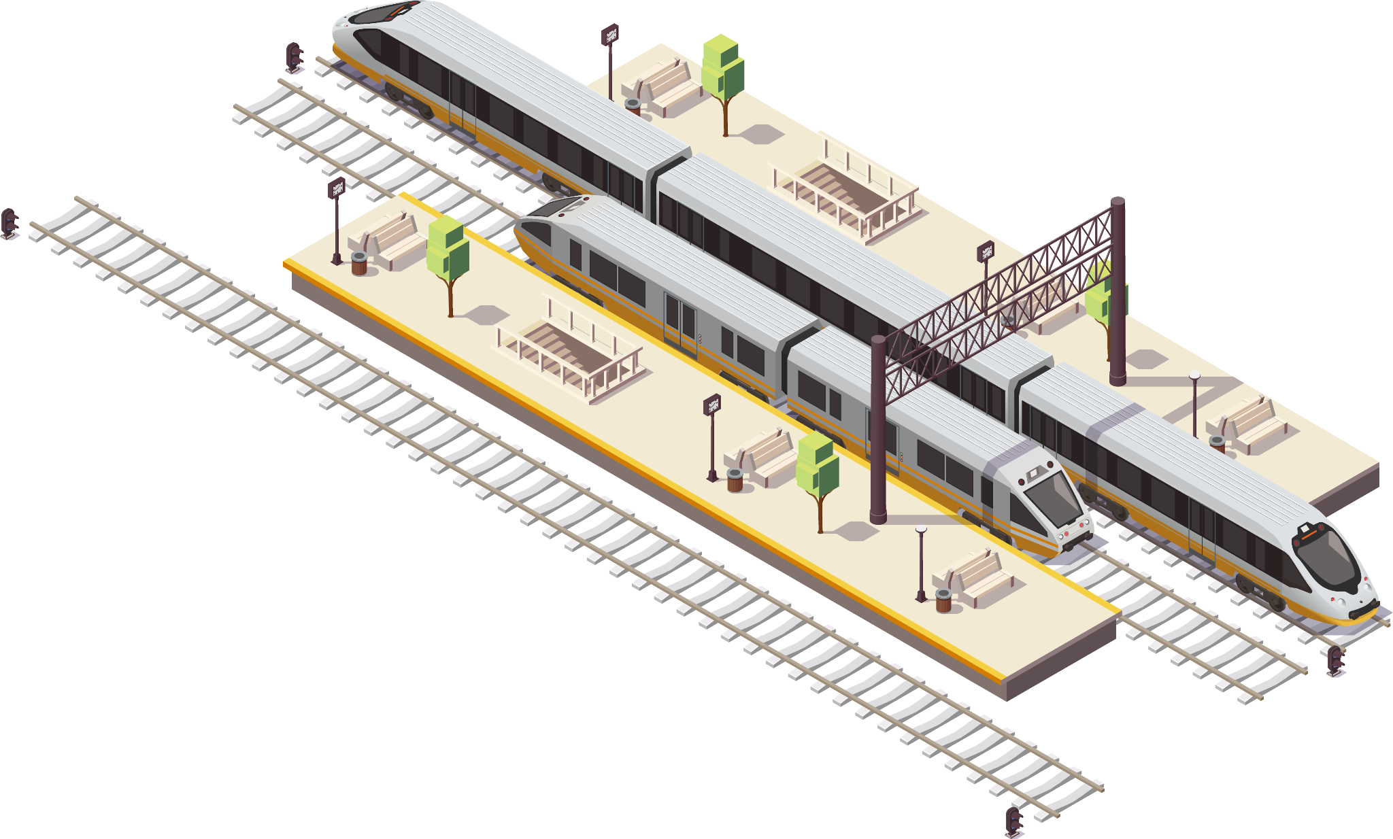
tube tunnel(l)ing
izgradnja podzemnih tunela
tunelovanje
cut-and-cover tunnel
tunel sa otvorenim iskopom
supply & demand
ponuda & potražnja

Slide 14
work-related traffic
leisure activity
saobraćanje do/od posla
slobodne aktivnosti
economic recession
off-peak
recesija
van špica
busy (traffic)
travel(l)ing environment
prometno
uslovi putovanja
retailing
in the wake (of)
maloprodaja
after a harmful event

Slide 15
customer satisfaction
performance
zadovoljstvo klijenata/potrošača
radna svojstva/učinak (performanse)
operating surplus
tackle (a problem)
poslovni višak
uhvatiti se u koštac
healthcare and education
enterprise
zdravstveni i obrazovni sistem
preduzeće
variable
investment
promenljiv, varijabilan (varijabla)
ulaganje
waste
scheme
gubitak
plan

Slide 16
fleet (of trains)
communications system
vozni park (železnice)
sistem komunikacije,
komunikacijski sistem
rolling stock
assets
šinski vozni park
aktiva, imovina, sredstvo
power supply
bids
napajanje
ponude
Note: in English we differentiate between assets (what you own) and liabilities (what you owe).
In Serbian, we have aktiva (supplies, real estate/office space, equipment, funds) vs. pasiva (which includes source of income).
operation
funkcionisanje, rad

Slide 17
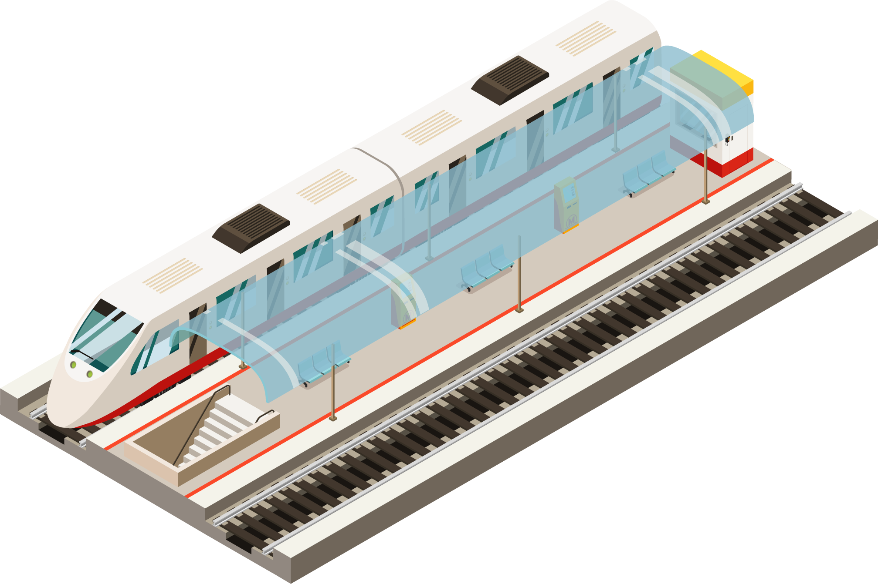
public ownership
operating undertaking
javno/državno vlasništvo
radni poduhvat
central government
vs.
local authority
asset supply
snabdevanje sredstvima
centralna vlada
/
lokalna vlast
campaigning
borba
line (business units)
bond issue
pruga (poslovne jedinice na pruzi)
izdavanje
obveznica

Slide 18
subsurface lines |  | Built with the cut-and-cover method (~5m below surface) | District, Metropolitan, Cicle, Hammersmith&City, East London lines
deep-level lines |  | Built by tunnel boring machines | Bakerloo, Central, Victoria, Waterloo&City* Northern, Piccadilly, Jubilee**
National Rail |  | Victoria and Waterloo&City | The only 2 lines in London that do not emerge onto the surface
through running |  | Jubilee | The deepest line in London at 32m below sea level
potpovršinske linije
dubinske linije
Britanska nacionalna železnica
dobra umreženost, povezanost

Slide 19
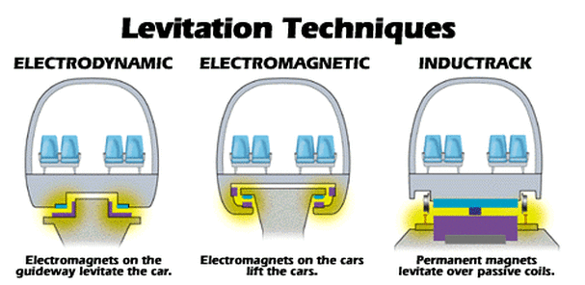
Additional vocabulary
peron
šine
kolosek
pruga
vozovi velikih brzina
Maglev trains: electromagnets lift the train up by 1cm: impossible to derail, collisions between 2 trains are impossible (synchronised electromagnetic waves), low energy consumption, low-intensity magnetic field (does not influence people), run only on maglev tracks – extremely expensive construction, low-expense upkeep.
platform
rails
track
railway, railroad
high-speed trains
Fun fact: usually, high-speed trains >300km/h
But, we consider them >160km/h

Slide 20
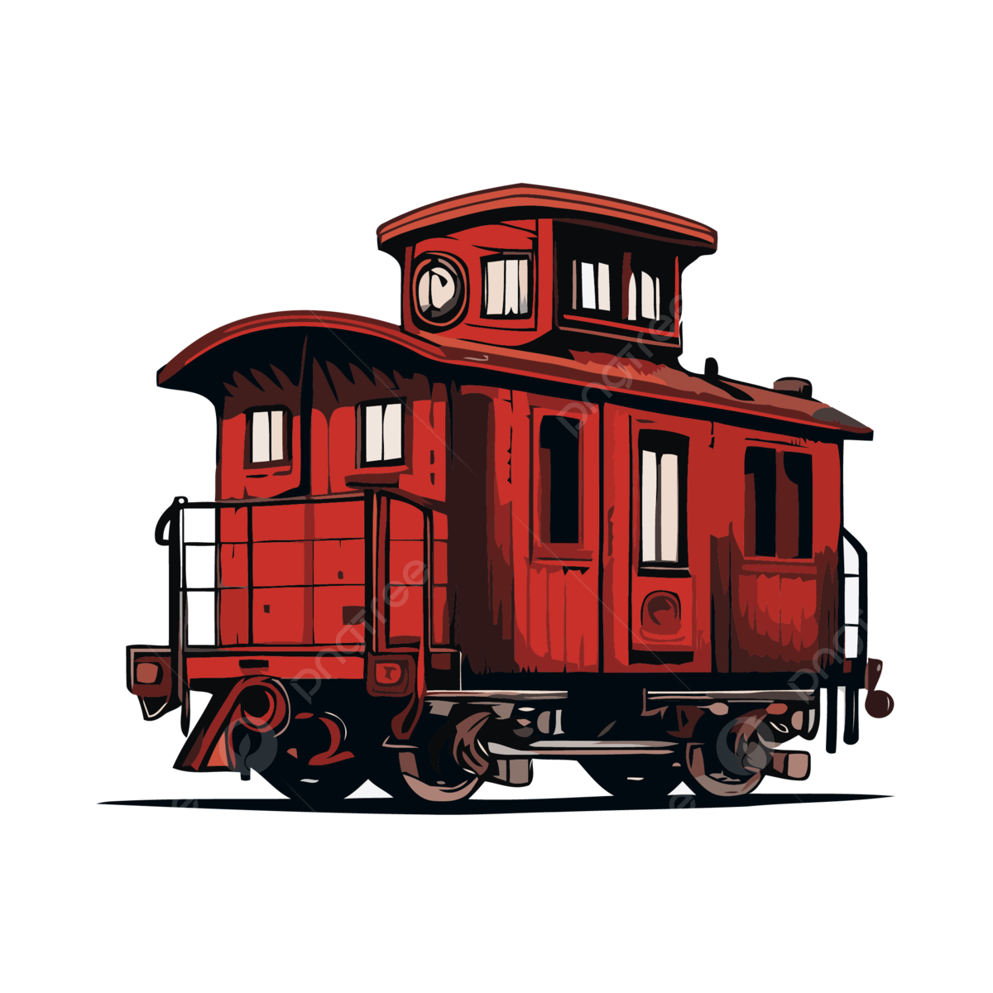
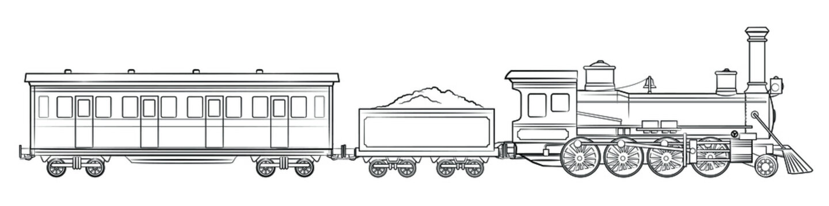
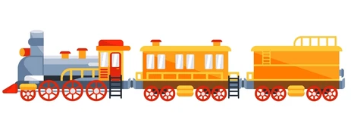
Parts of a steam train
Locomotives can either be steam, diesel, or electric
Passenger – coach / carriage;
Freight –
wagon!
Combined - both
Tender
(wood,
coal, oil...)
Locomotive
(firebox, boiler, throttle, steam dome, smokebox, valves, pistons...)
Caboose
(rear end: crew, kitchen...)

Slide 21
Vocabulary exercises & Discussion
04

Slide 22
Fill in the blanks with the following words:
diesel • train driver • inside • separate • switch points • power • motors • located • levers
Propulsion for the train is provided by a _____ locomotive, or by individual ____ in self-propelled multiple units. Most modern trains are powered by ­­­____ locomotives or by electricity supplied by overhead wires or additional rails, although historically the steam locomotive was the dominant form of locomotive _____.
The cab, crew compartment or driver's compartment is the part of the locomotive housing the _____ (who operates the machinery using ____) and the controls necessary for the locomotive's operation; for example, the operation of _____, which are pieces of railway line that can be moved to change the direction of a train. On steam locomotives, the cab is normally ____ to the rear of the firebox. The cab of a diesel or electric locomotive is either ____ a cabin or forming one of the structural elements of a cab unit locomotive.

Slide 23
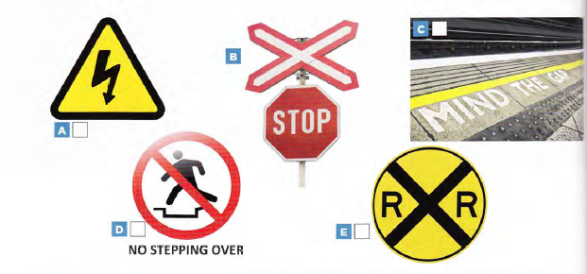
Here are some common railway signs. Match the signs to their meanings.
1. railroad crossing
2. St Andrew Cross: stop and check for an approaching train
3. danger: high voltage
4. don't cross the tracks
5. step over the gap when getting on and off a train

Slide 24
You are probably familiar with the small buildings standing next to railway lines, but possibly do not know what they are used for. These constructions are known as signal boxes or switch towers, and were fundamental for the development of the railway system. The signal box was first used in the mid-19th century, and was a space for signal men to control the direction of trains and ensure the safety of passengers and vehicles. At first, this job was carried out manually by moving levers to move the track, but with the invention of electrical and electronic technology, the signal man's job changed radically.
First, he was able to control much larger areas of track from a control panel, and could communicate directly with trains by radio or telephone, and later he was able to perform all of these tasks by computer. Eventually, the signal box fell into disuse. Today most signaling is controlled centrally by very sophisticated computers, but for many years the simple signal box guaranteed safe rail travel al l over the world; and perhaps many of these little buildings still exist to remind us of their important role in the development of the railway system. Fun fact: the Guiness World Record for the smallest pub was made out of an old signal box!
1 What was the purpose of the signal box?
2 What innovations changed the job of the signalman?
3 How did the signalman communicate with trains?
4 Why are signal boxes no longer in use? Why do they still exist?
Read the text and answer the questions in the box.

Slide 25
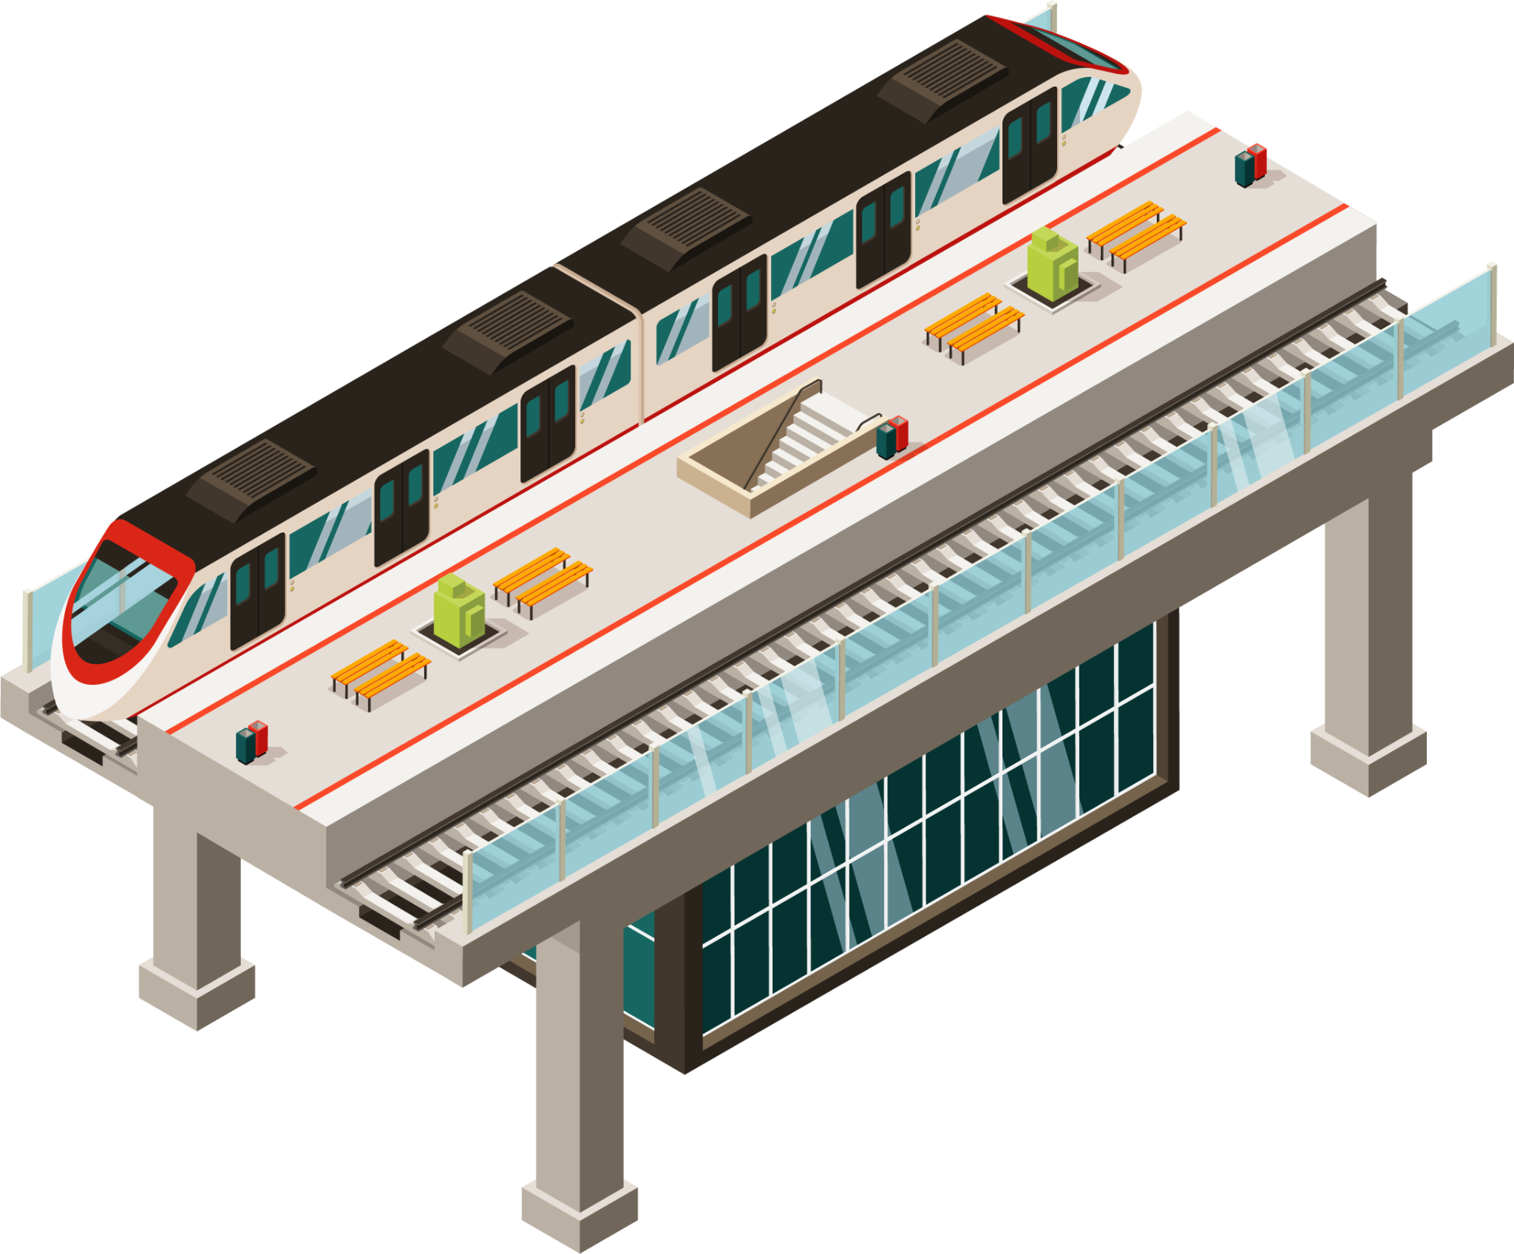

1825
574.8 km/h
Mock Test time!
World’s first railway Stockton-Darlington
France TGV speed

Slide 26
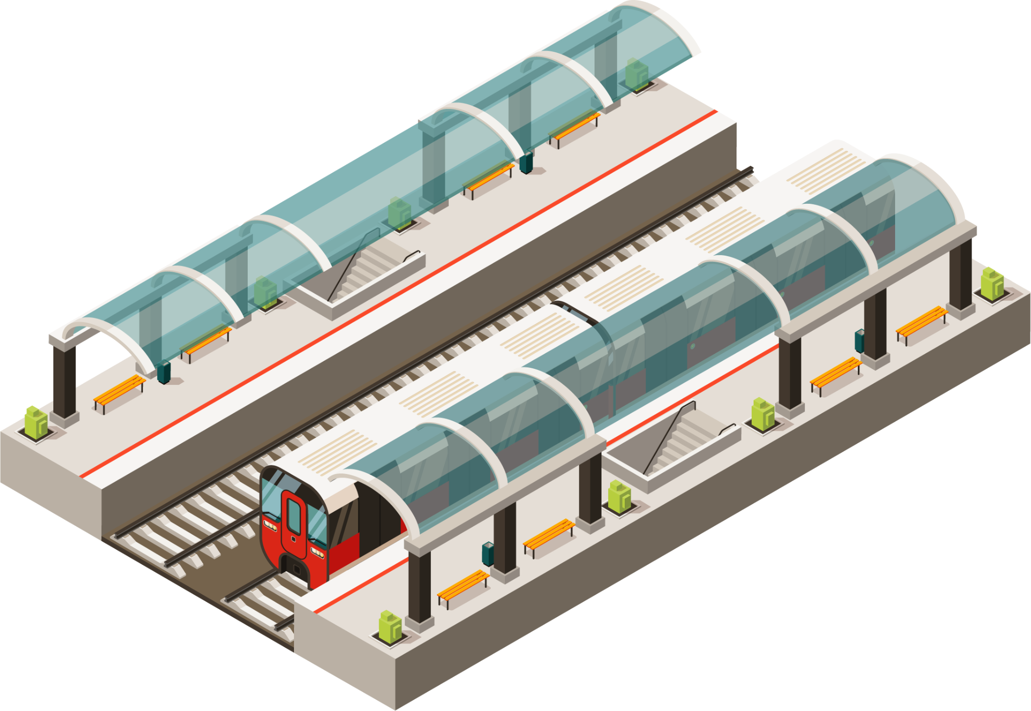
Discussion:
Would you like to learn how to drive a train? Why/why not?
Would you prefer to drive a lorry or a train? Why?
Which means of transport is the most difficult to drive according to you? Why?

